Slide 1
Guam Elicitation Discussion Round 1
August 14th / August 15th

Slide 2
Variable BTS Control Scenarios
Scenario | Species | Fence | BTS Control | Rodent Control | Cat Control | Dog Control | Ungulate Control | Supplemental Resources | Habitat Restoration | Education and People Management
Scenario 1a | Conditioned on Sali or Ko’ko’ being at the site | Snake barrier (and ungulates) | Assume eradication | Ongoing rodent control | Ongoing cat control | Dog eradication | Ungulate eradication | Nest boxes | Remove non-natives, plant natives | Area Closures
Scenario 1b | Conditioned on Sali or Ko’ko’ being at the site | Snake barrier (and ungulates) | Assume ongoing aerial bait drops | Ongoing rodent control | Ongoing cat control | Dog eradication | Ungulate eradication | Nest boxes | Remove non-natives, plant natives | Area Closures
Scenario 1c | Conditioned on Sali or Ko’ko’ being at the site | Snake barrier (and ungulates) | Assume ongoing aerial bait drops + supplemental captures | Ongoing rodent control | Ongoing cat control | Dog eradication | Ungulate eradication | Nest boxes | Remove non-natives, plant natives | Area Closures

Slide 3
Variable BTS control, no rodent control, and only problem cats are removed scenarios
Scenario | Species | Fence | BTS Control | Rodent Control | Cat Control | Dog Control | Ungulate Control | Supplemental Resources | Habitat Restoration | Education and People Management
Scenario 2a | Conditioned on Sali or Ko’ko’ being at the site | Snake barrier (and ungulates) | Assume eradication | No rodent control | Targeted cat removal | Dog eradication | Ungulate eradication | Nest boxes | Remove non-natives, plant natives | Area Closures
Scenario 2b | Conditioned on Sali or Ko’ko’ being at the site | Snake barrier (and ungulates) | Assume ongoing aerial bait drops | No rodent control | Targeted cat removal | Dog eradication | Ungulate eradication | Nest boxes | Remove non-natives, plant natives | Area Closures
Scenario 2c | Conditioned on Sali or Ko’ko’ being at the site | Snake barrier (and ungulates) | Assume ongoing aerial bait drops + supplemental captures | No rodent control | Targeted cat removal | Dog eradication | Ungulate eradication | Nest boxes | Remove non-natives, plant natives | Area Closures

Slide 4
No forest restoration scenario
Scenario | Species | Fence | BTS Control | Rodent Control | Cat Control | Dog Control | Ungulate Control | Supplemental Resources | Habitat Restoration | Education and People Management
Scenario 3 | Conditioned on Sali or Ko’ko’ being at the site | Snake barrier (and ungulates) | Assume eradication | Ongoing rodent control | Ongoing cat control | Dog eradication | Ungulate eradication | Nest boxes | None | Area Closures

Slide 5
Sali Parameters
Adult survival: annual survival probabilities for birds that are 1 year old or older.
Juvenile survival: survival probabilities of juveniles from 1 month post-fledge to 1 year of age (i.e., over an 11-month period).
Fledgling survival: survival probabilities of birds that are fledglings (i.e., just left nest) to 1 month post-fledge.
Nest success: probability that a nest produces ≥1 fledgling.
Fledglings per nest: the number of fledglings produced per successful nest.
Nest attempts: the number of nesting attempts per adult per year.

Slide 6
Results Discussion
Continue discussion online, using a Google document
Leave comments that
ask or answer questions
share your thoughts or rationale for specific values
Timeline:
Sali and Ko’ko’ Round 1 discussion
August 15th or 16th – August 31st
I will send out a link to a Google Document tomorrow
Undergo another round
Round 2 Google Sheets sent out September 1st and will be due on September 15th
Do these timelines work for everyone?

Slide 7
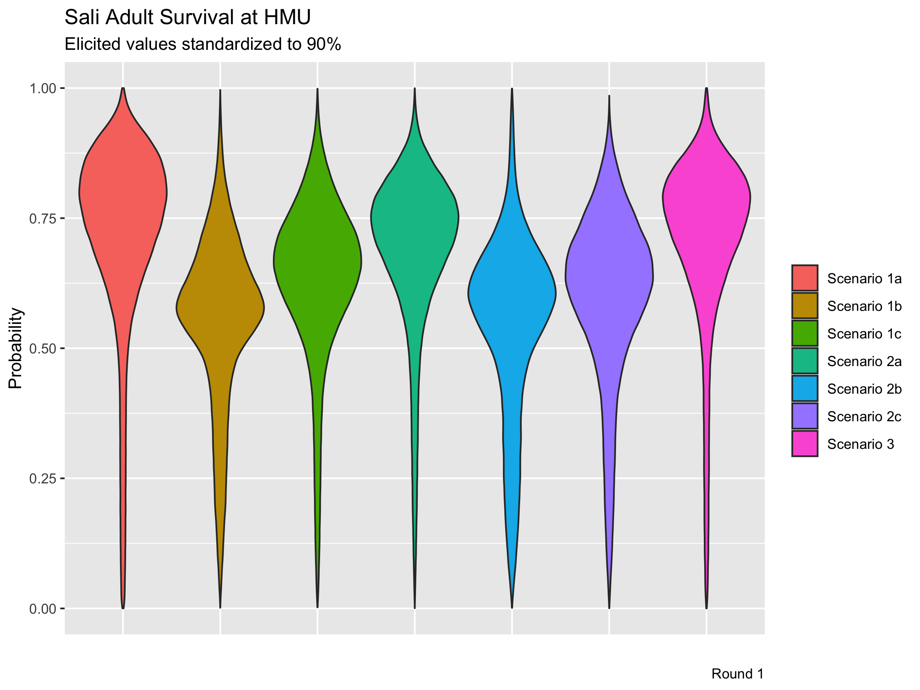

Slide 8


Slide 9


Slide 10


Slide 13
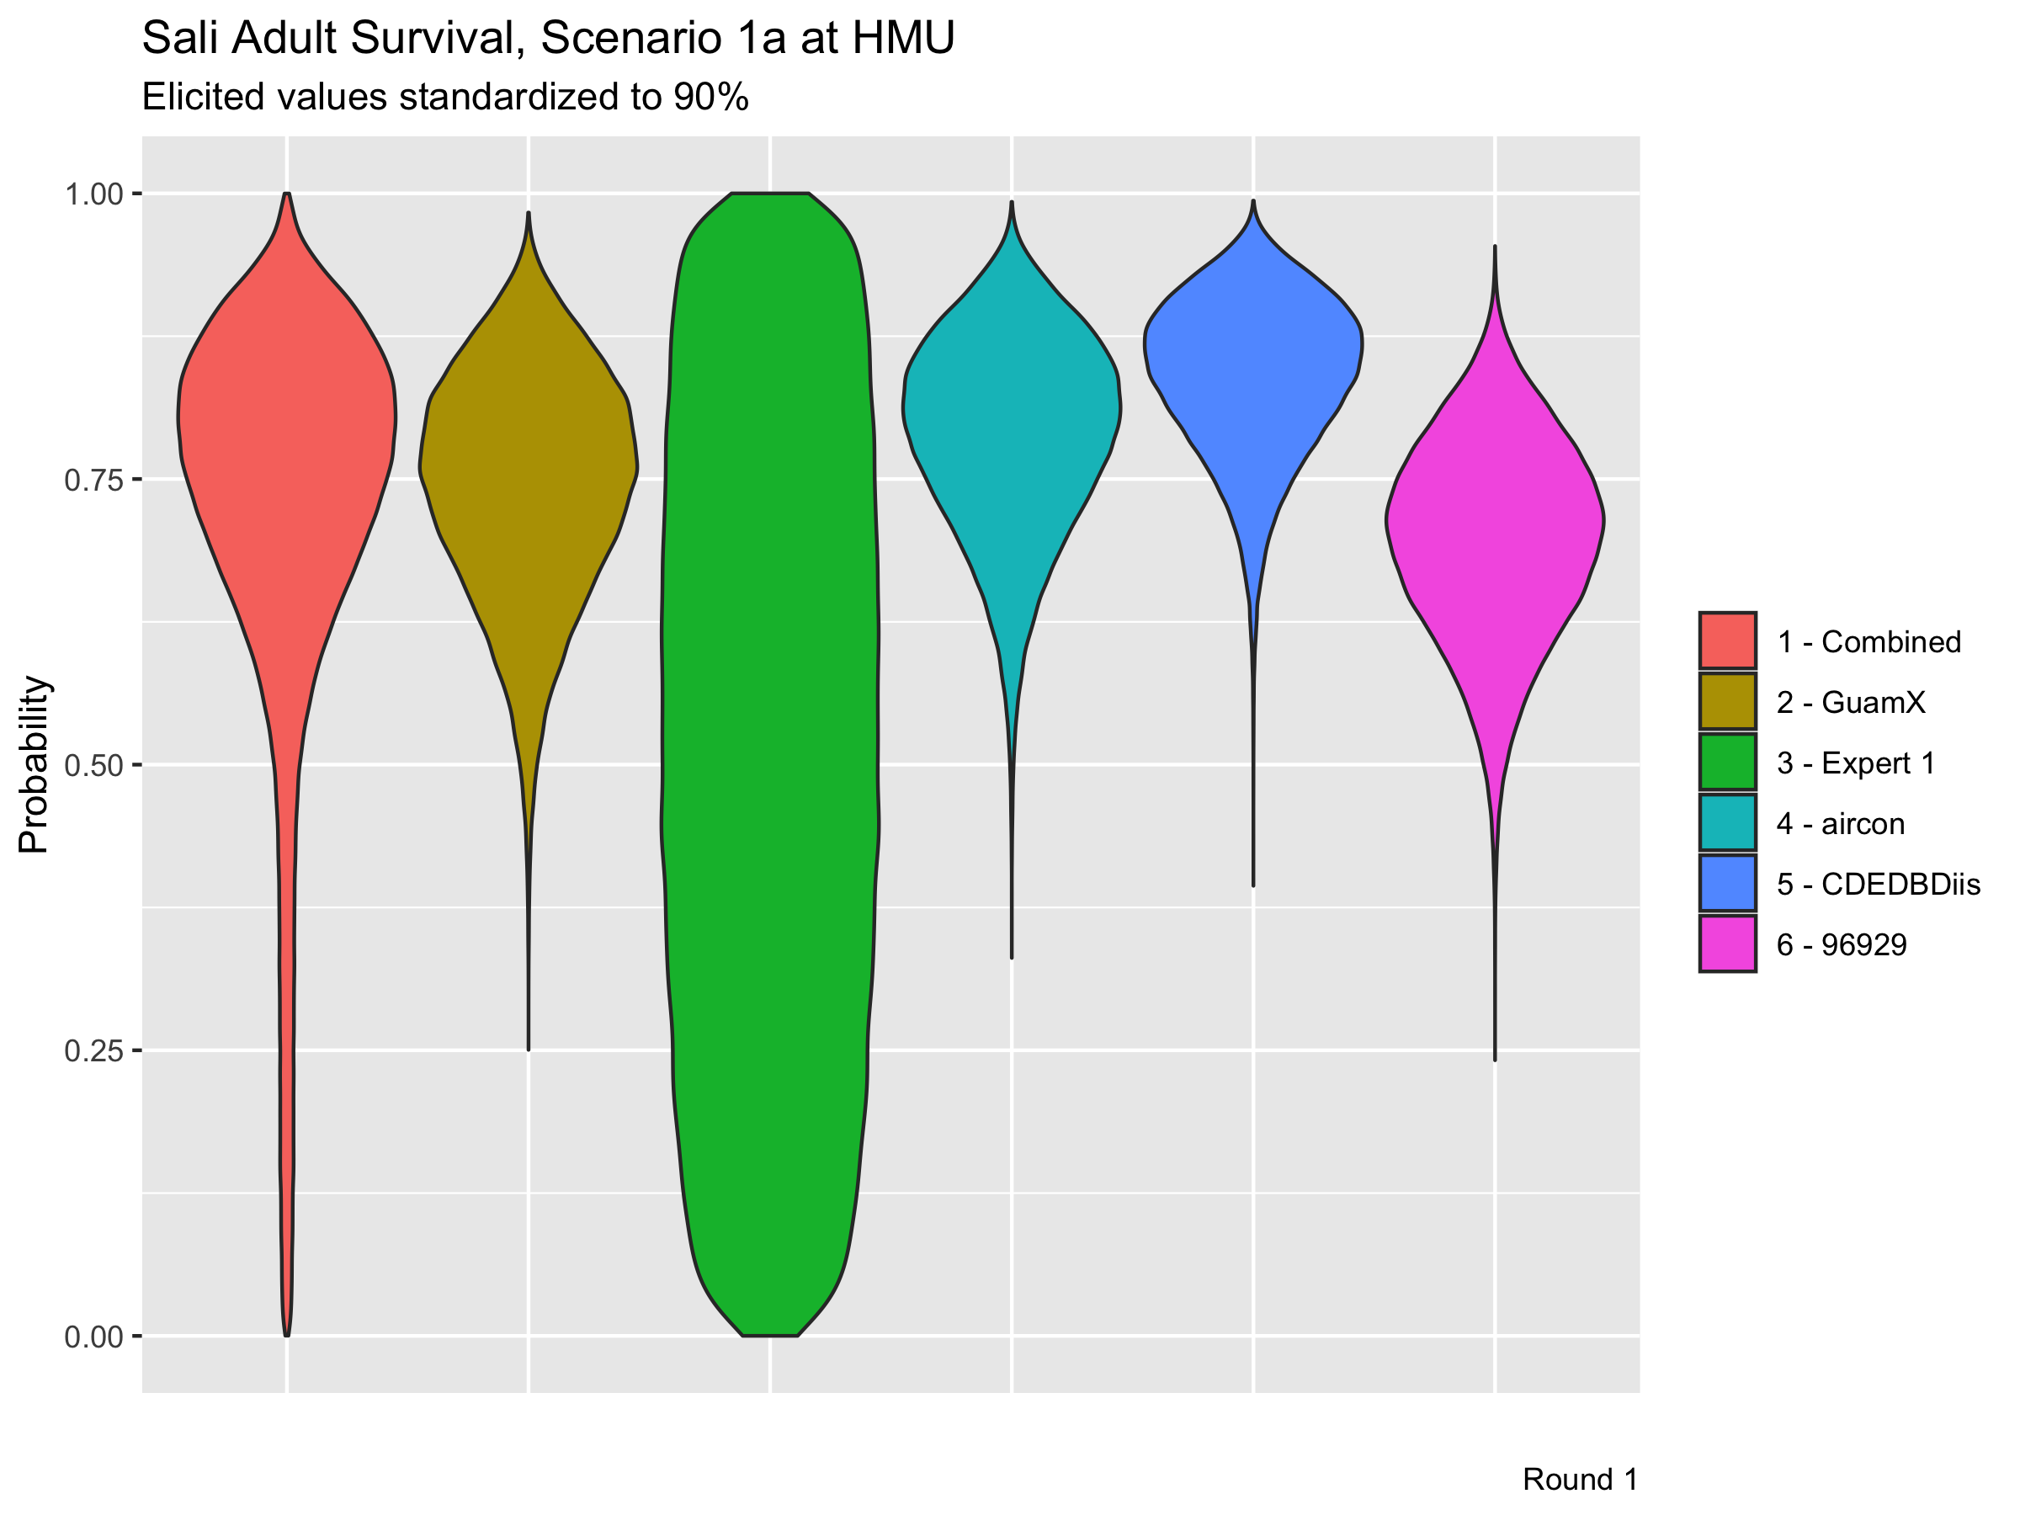

Slide 14
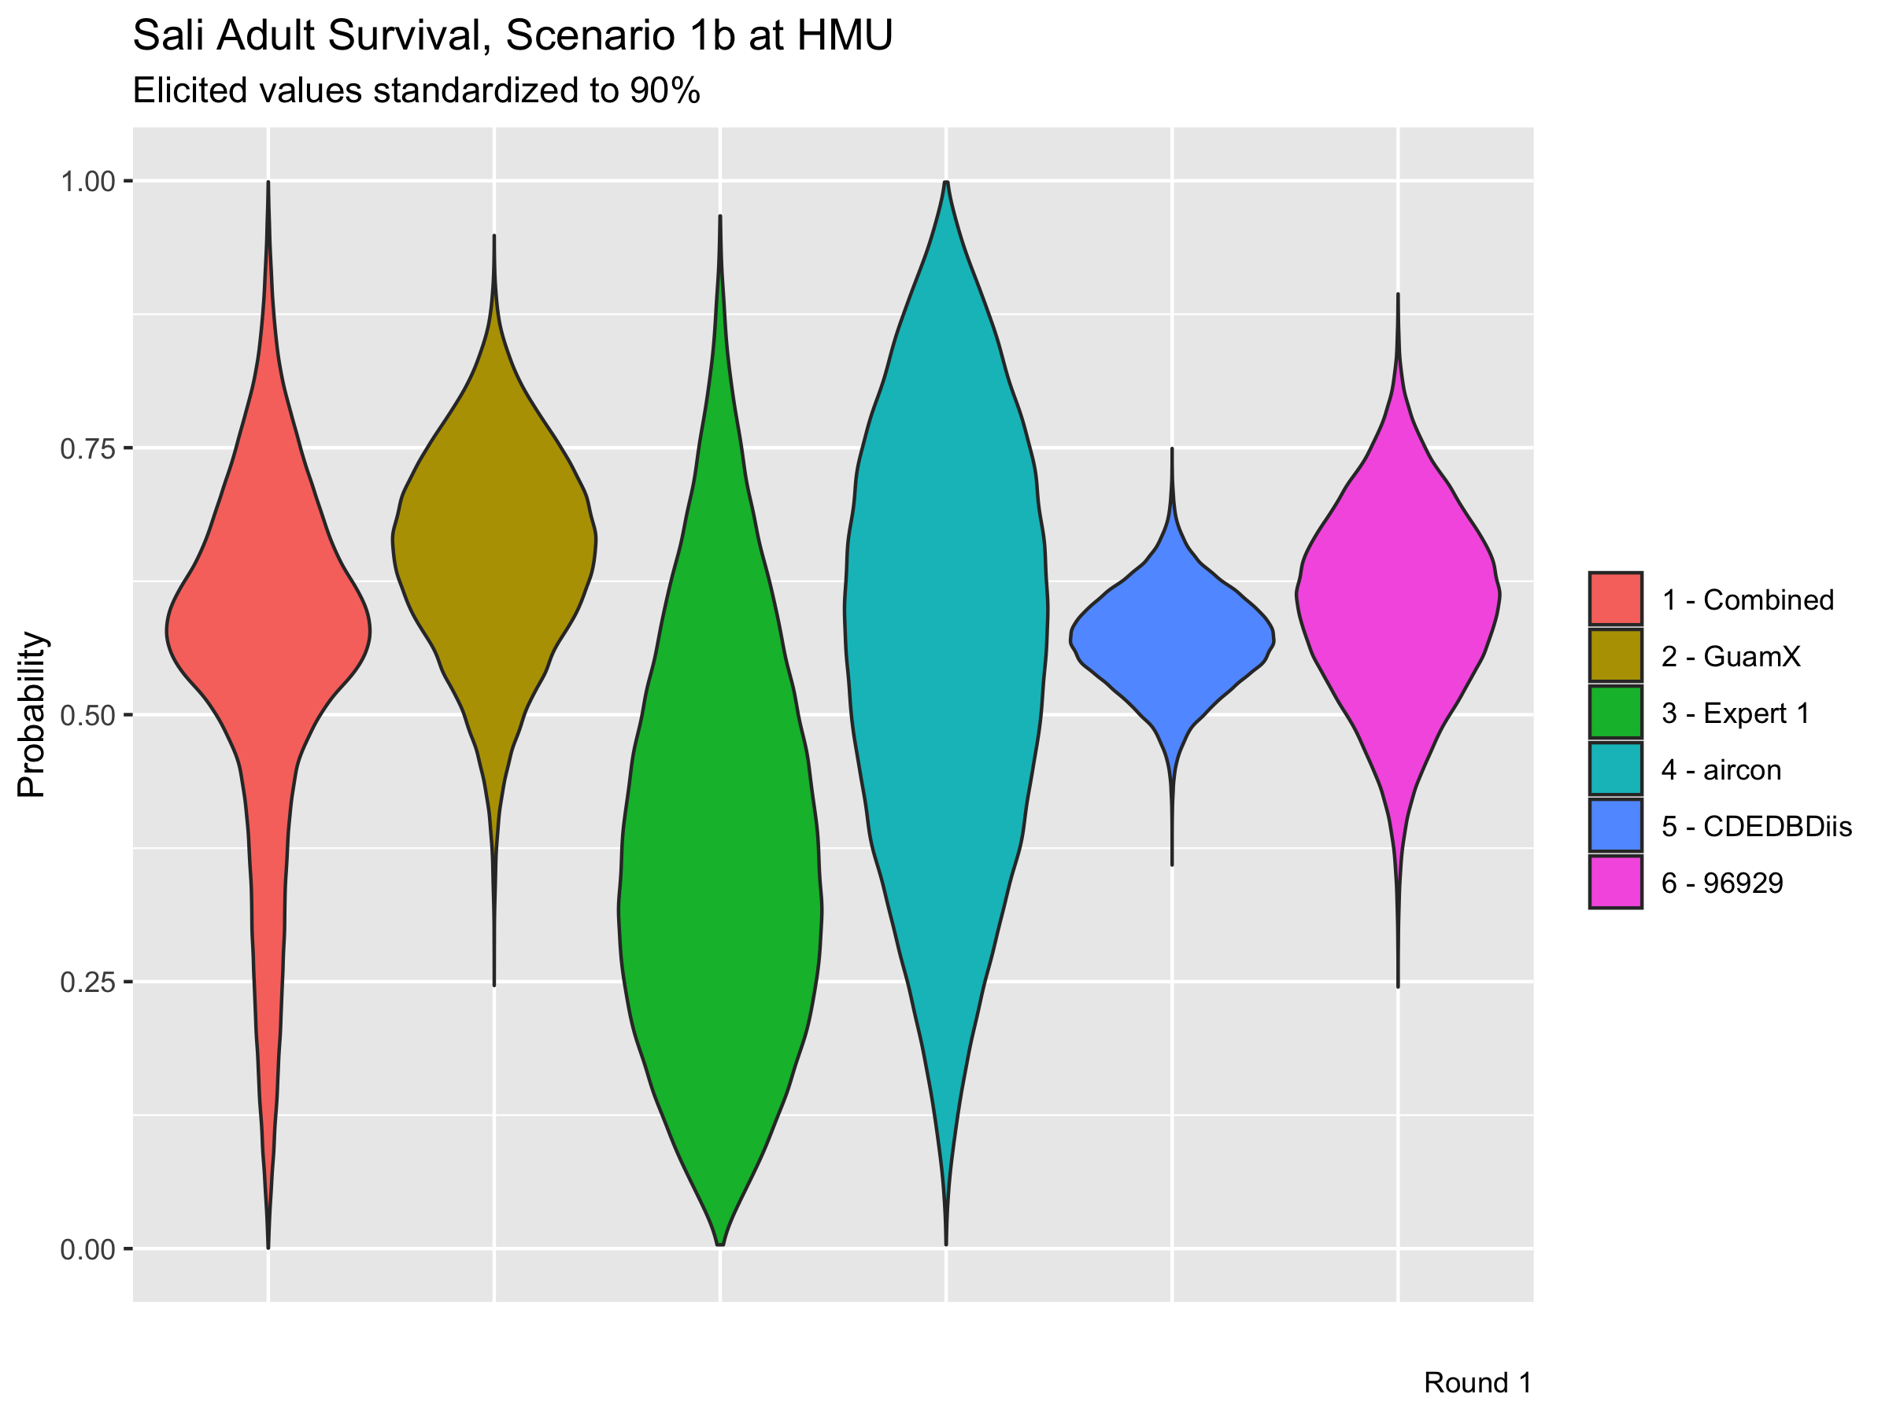

Slide 15
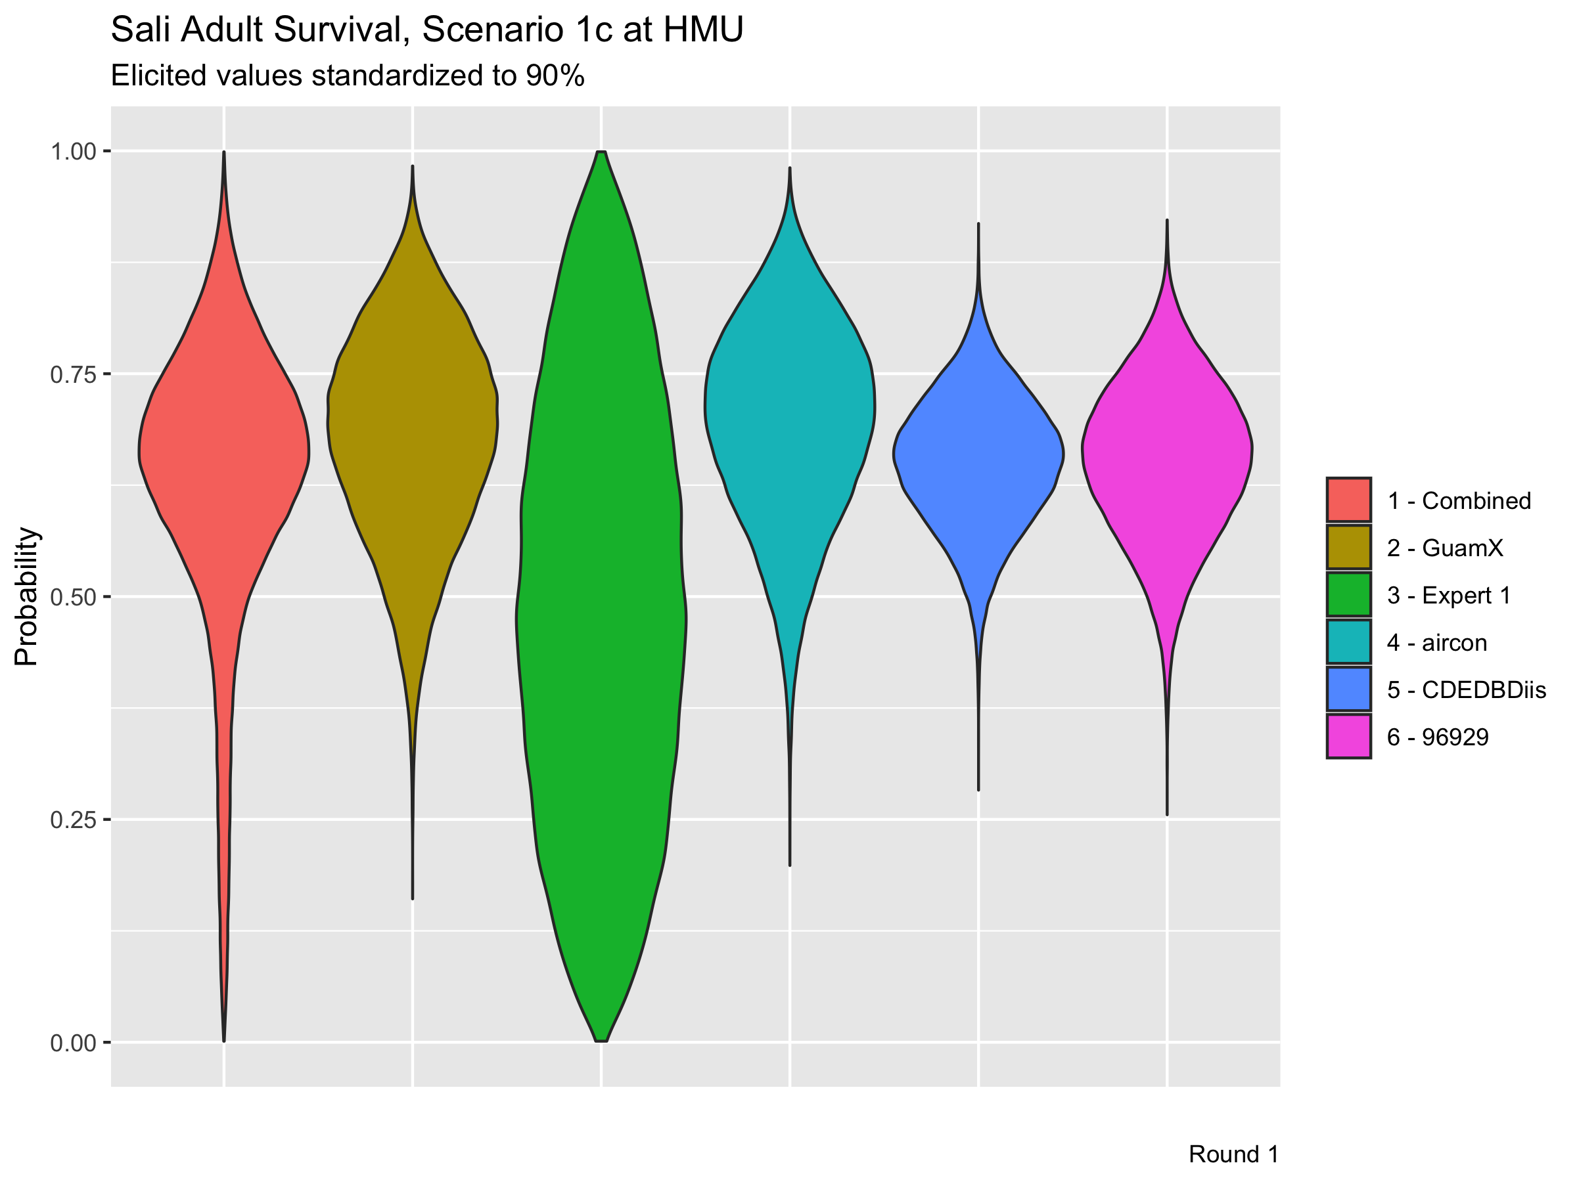

Slide 16
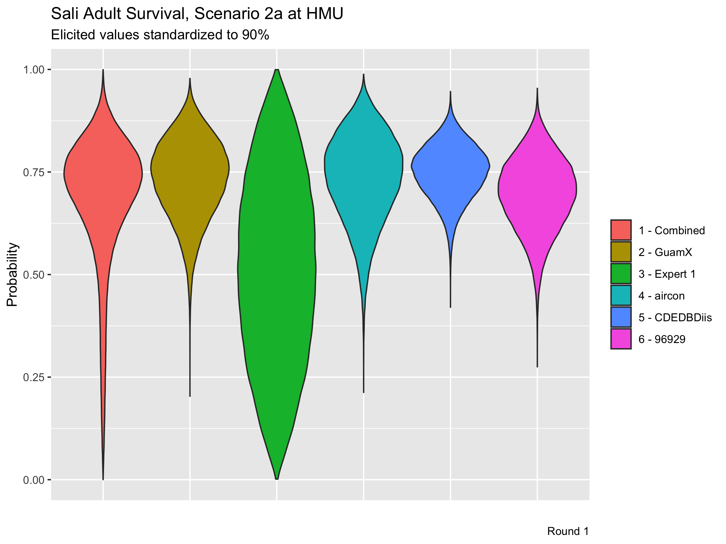

Slide 17
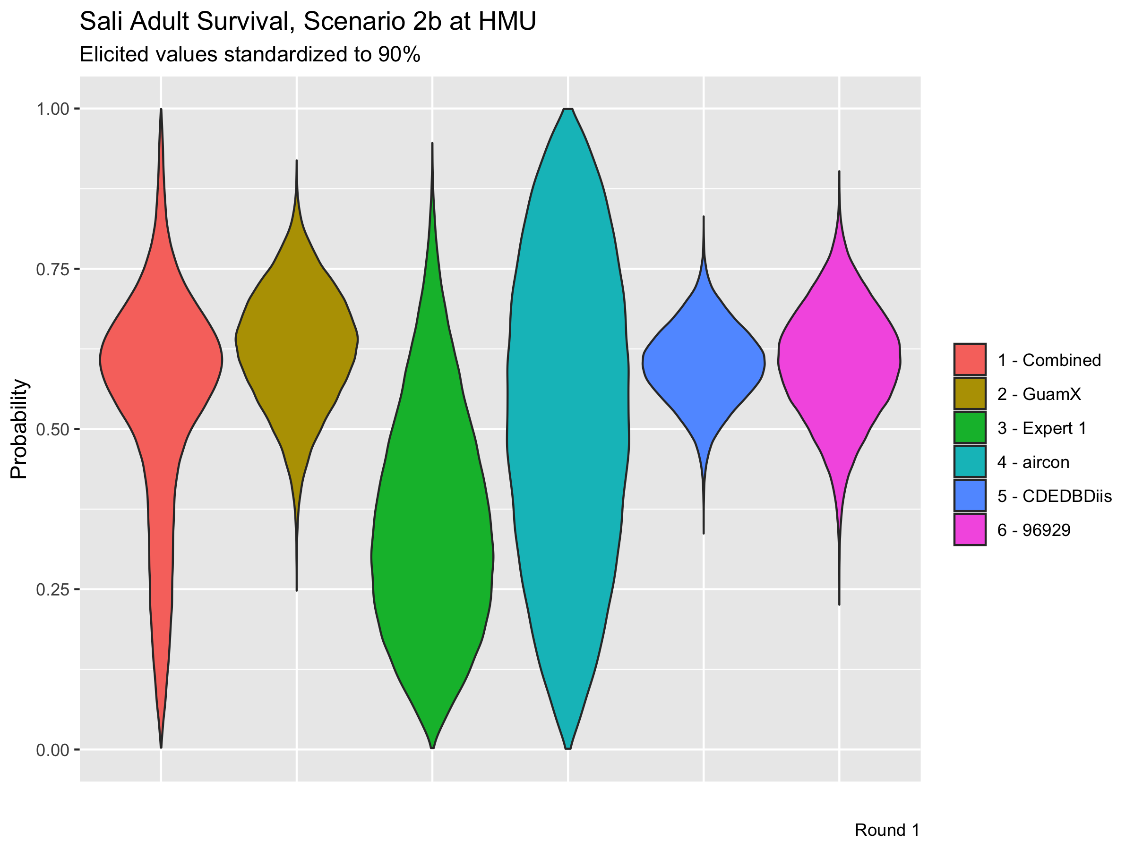

Slide 18
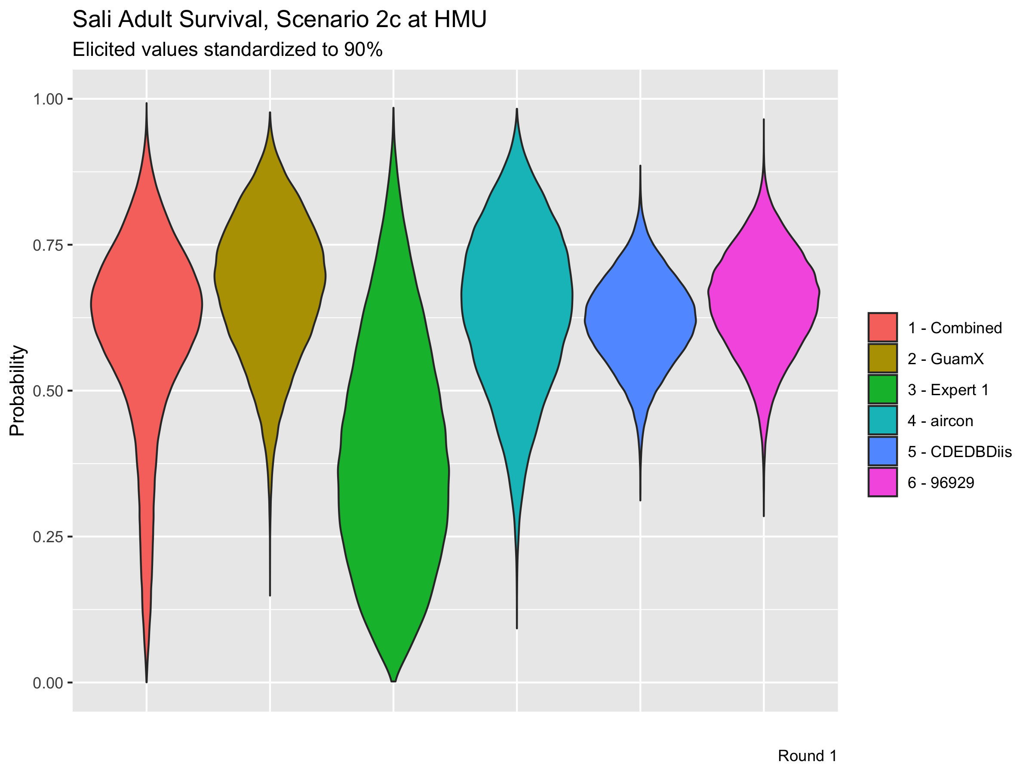

Slide 19
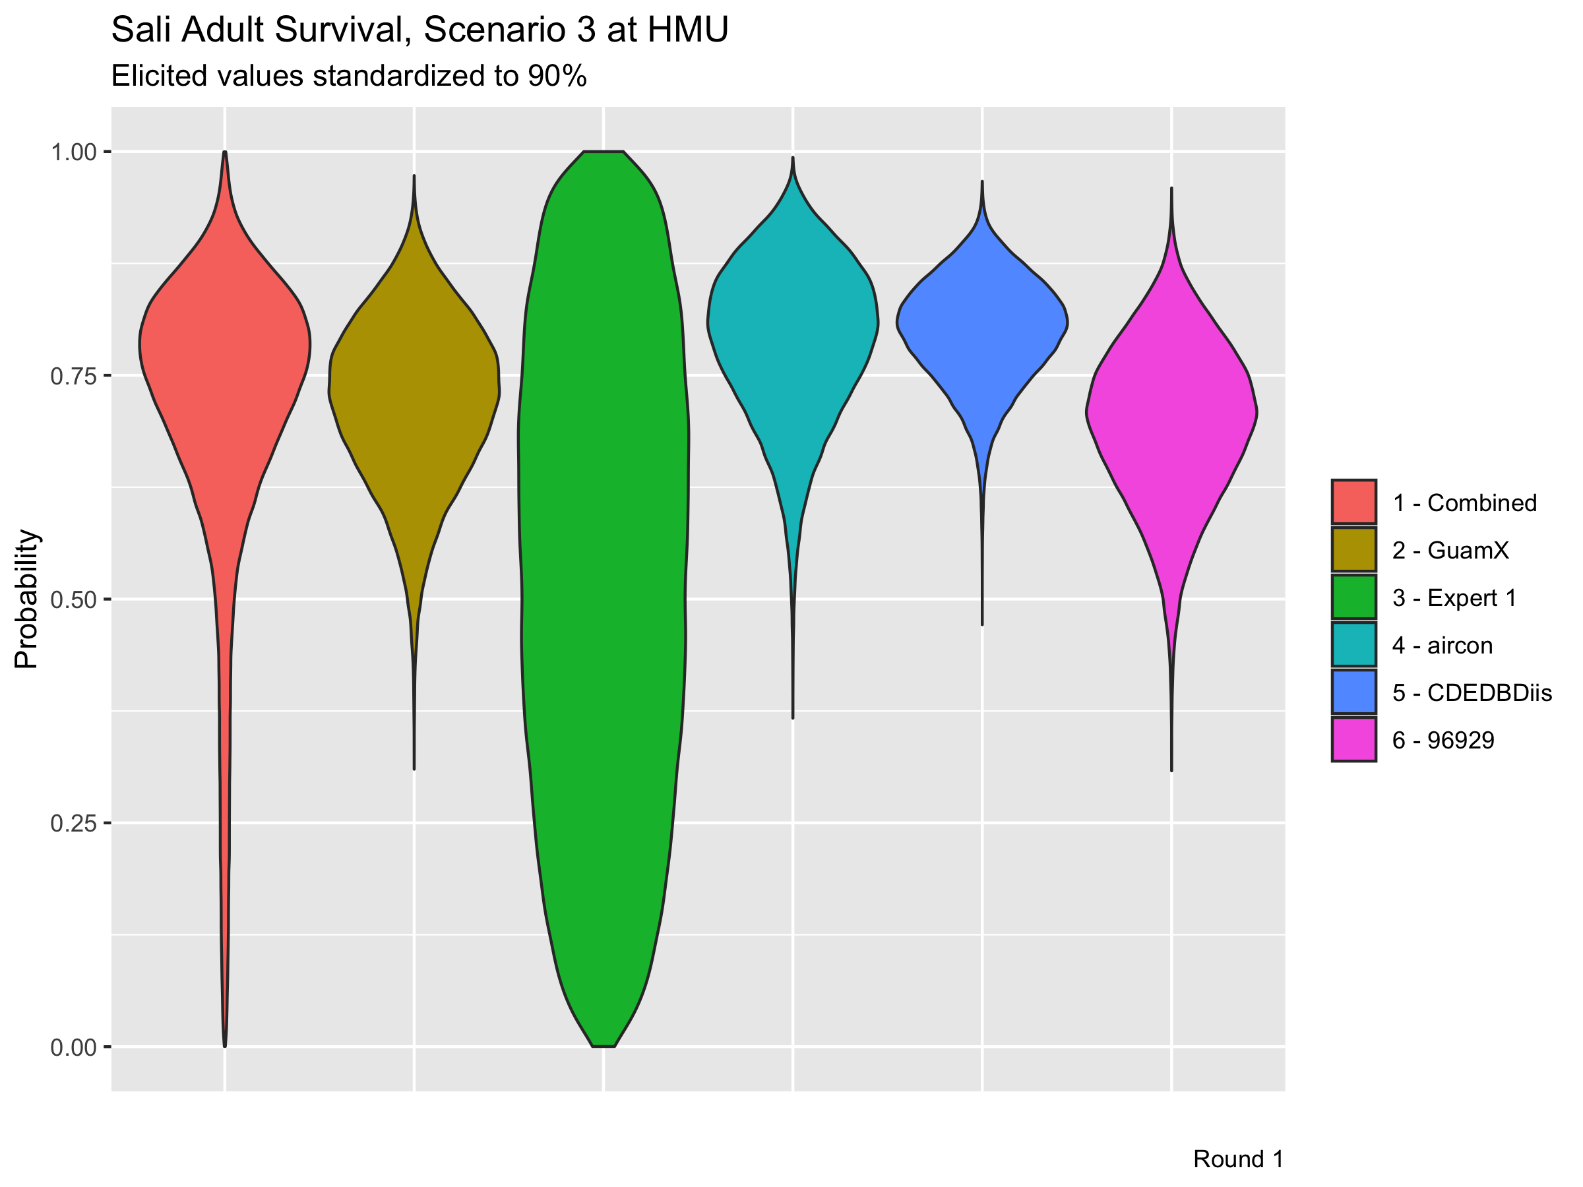

Slide 22
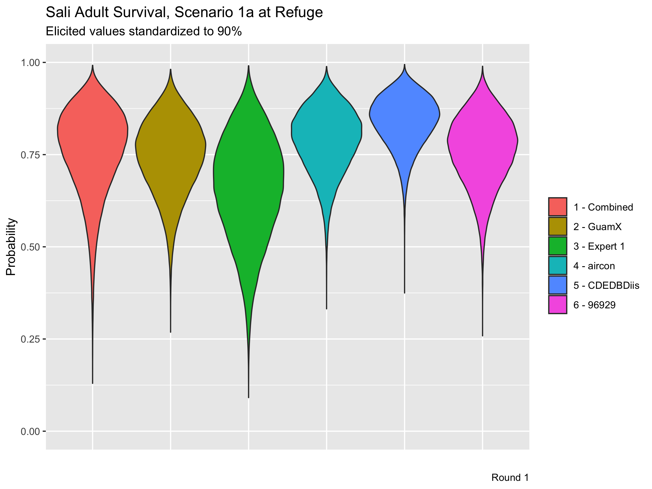

Slide 23
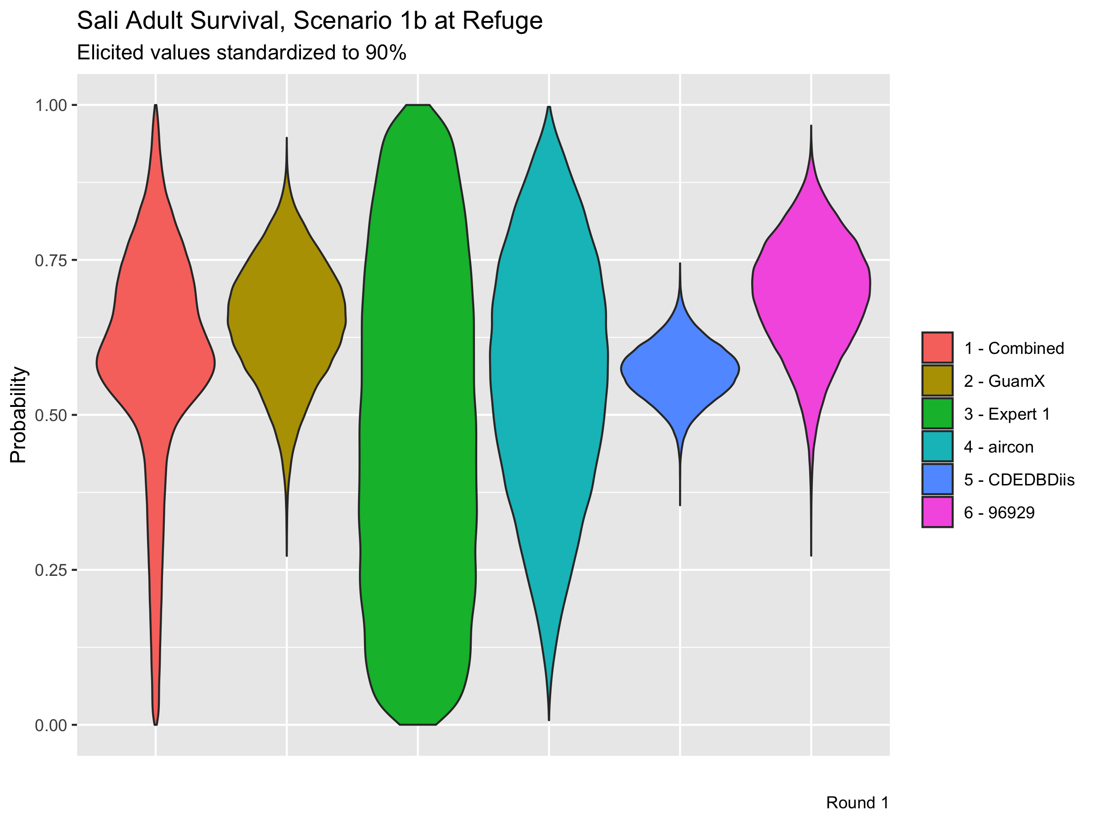

Slide 24
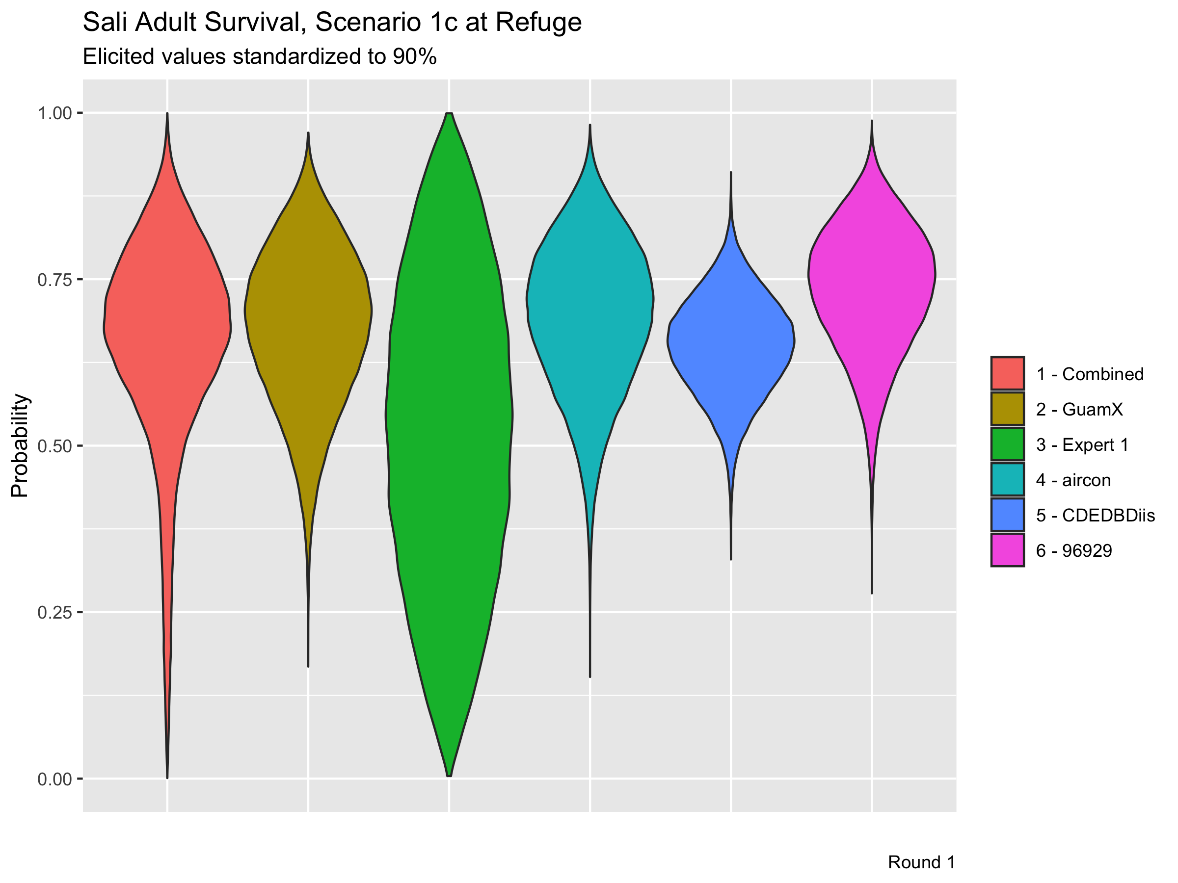

Slide 25
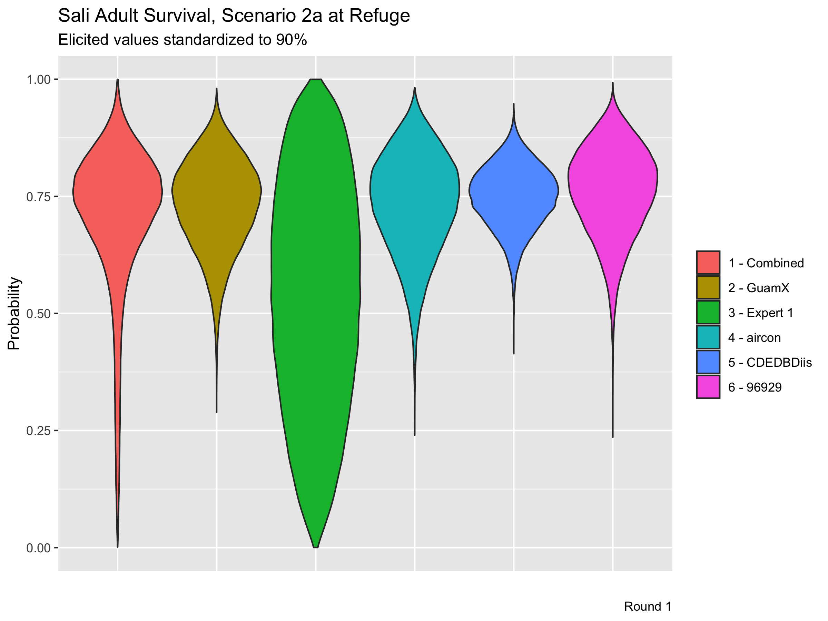

Slide 26
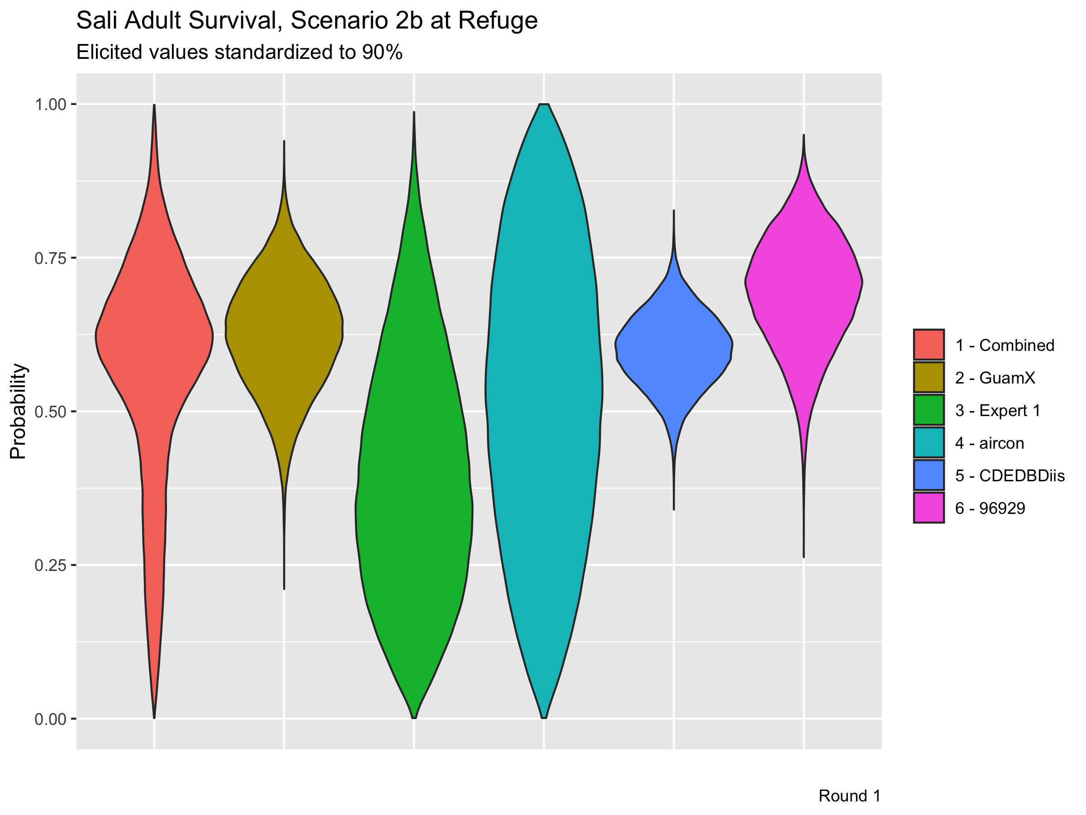

Slide 27
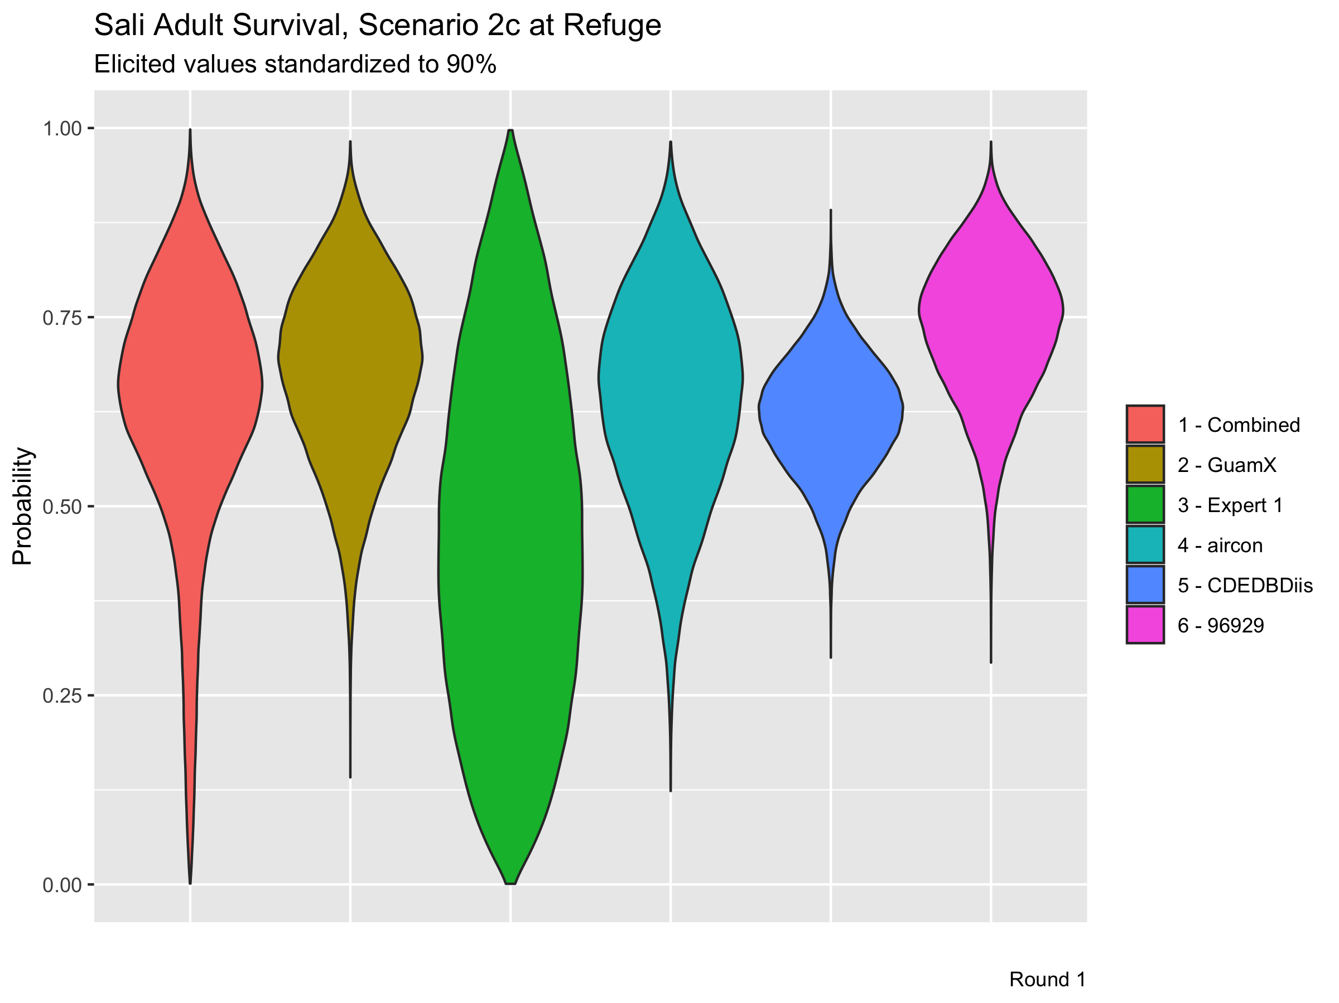

Slide 28
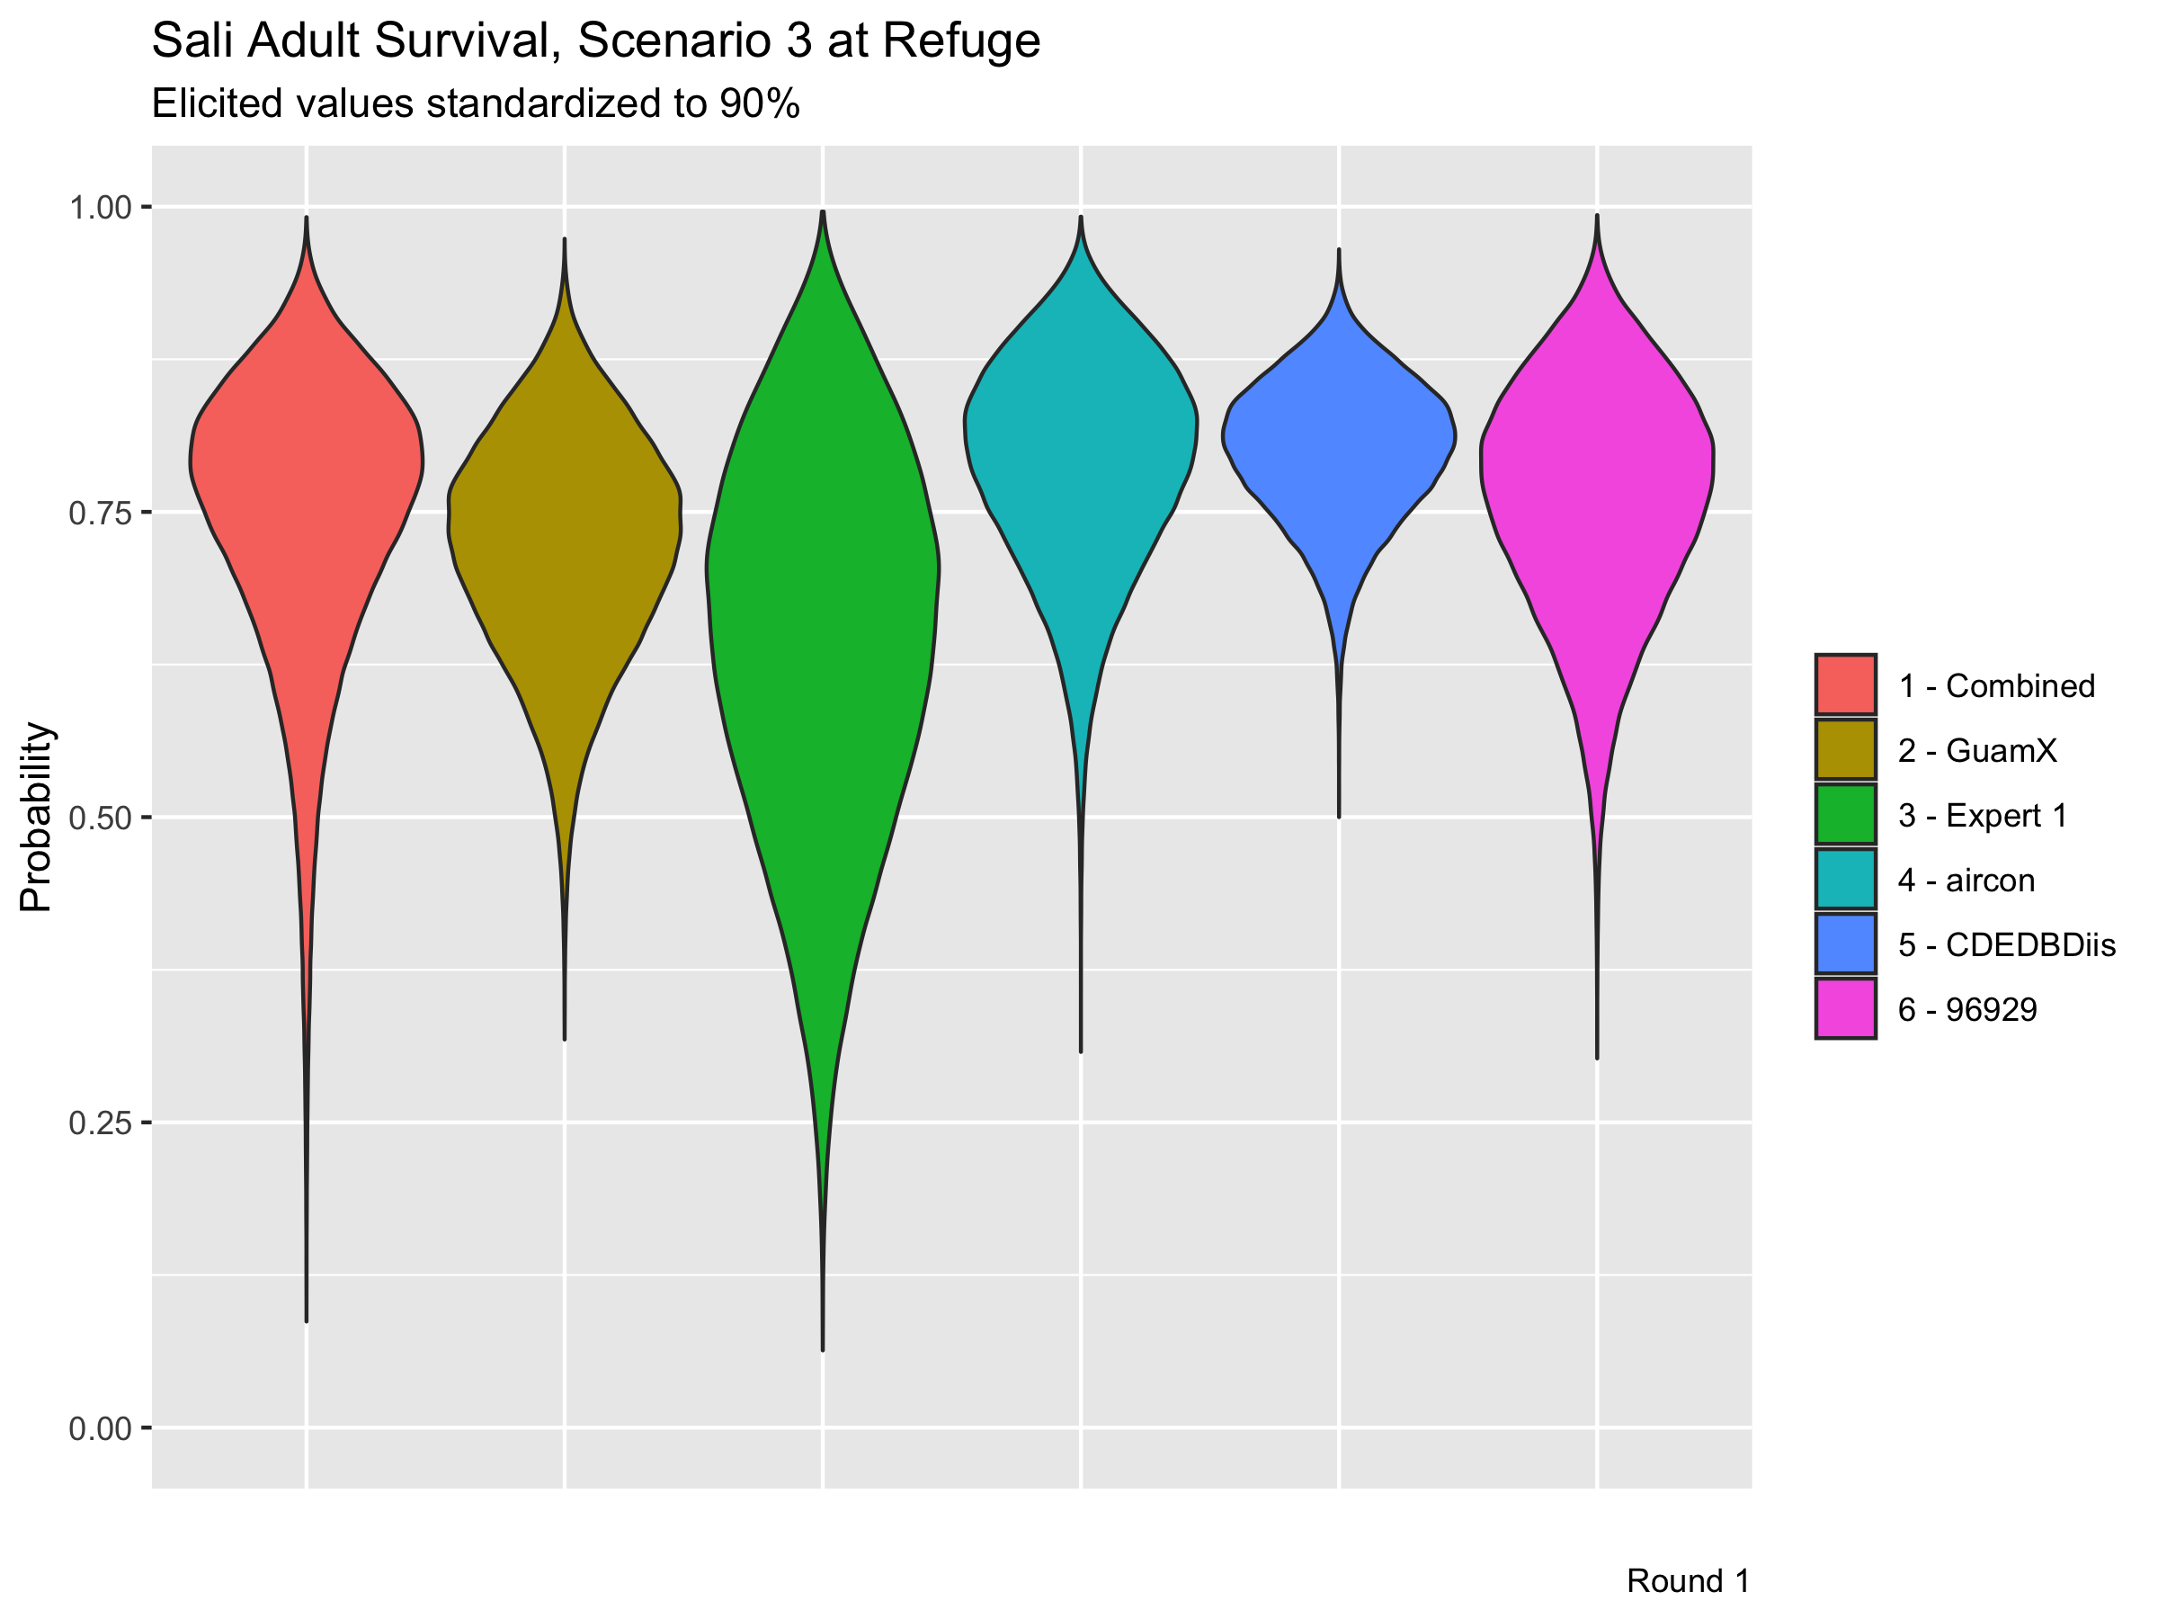

Slide 31
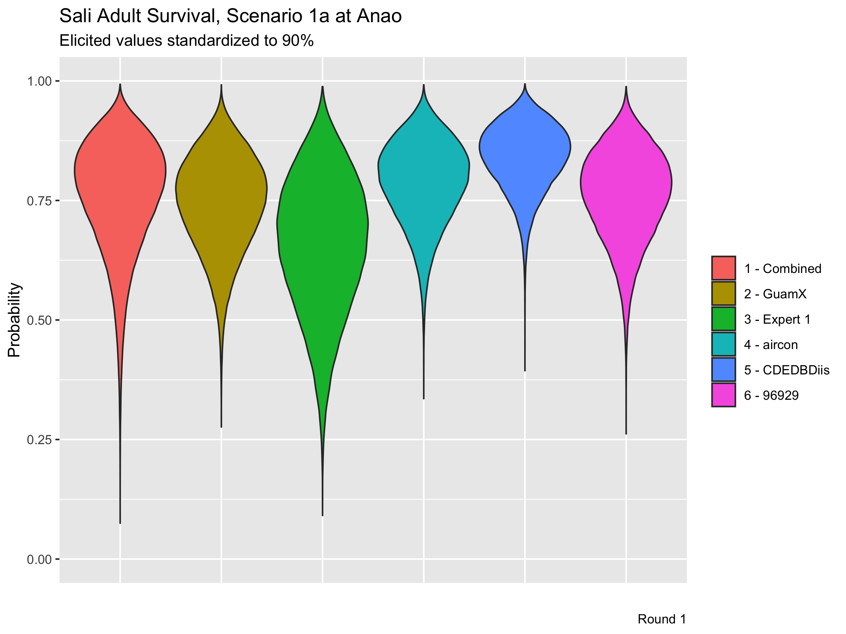

Slide 32


Slide 33
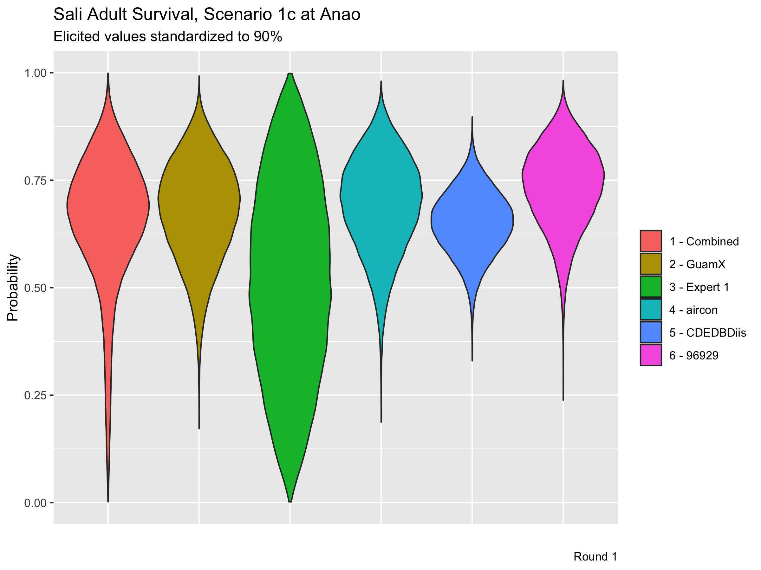

Slide 34
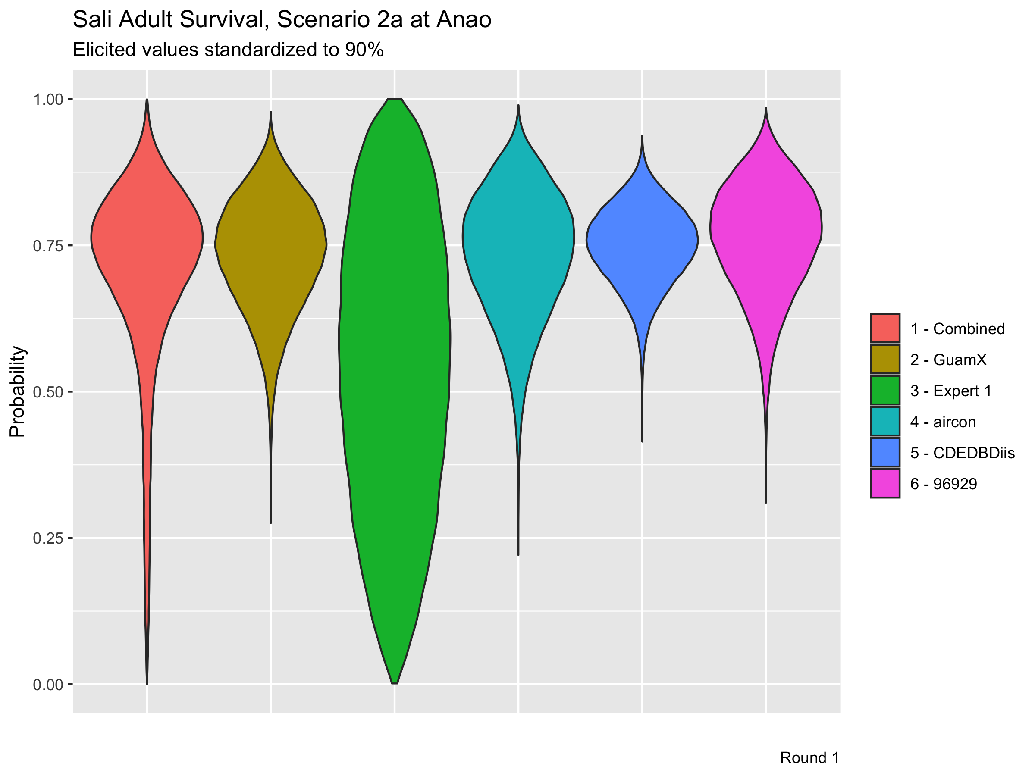

Slide 35


Slide 36


Slide 37


Slide 40
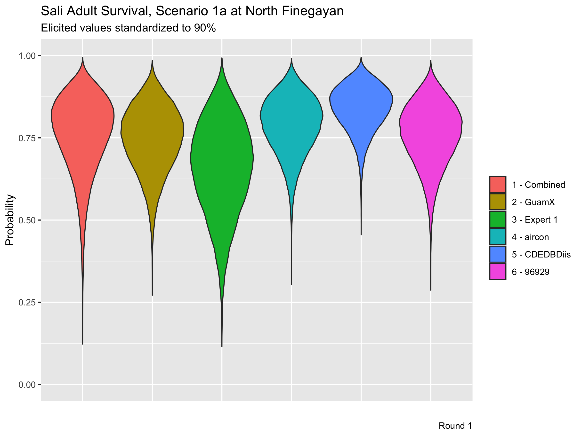

Slide 41


Slide 42
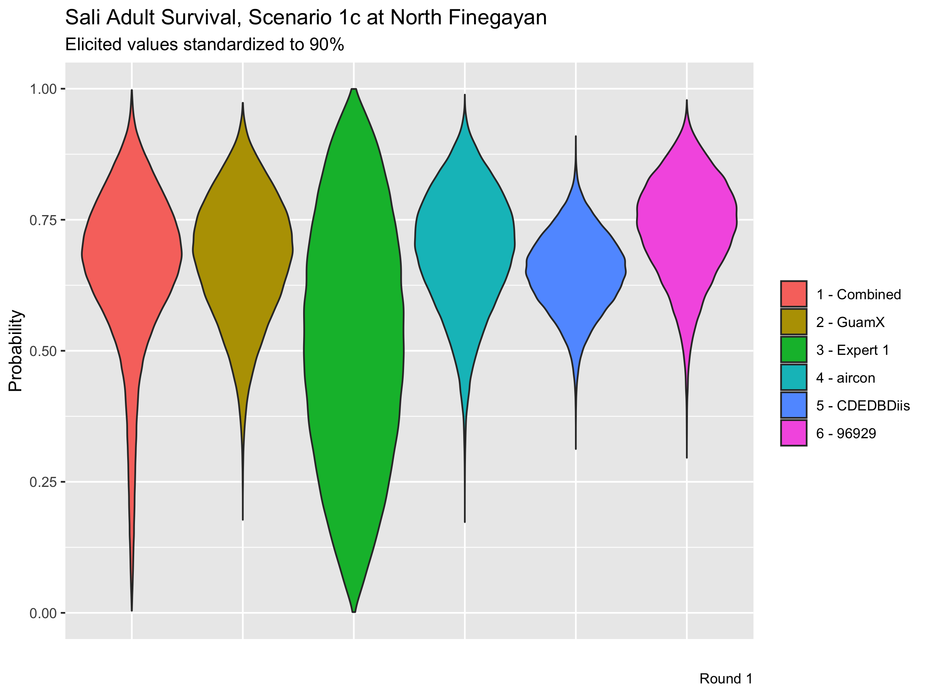

Slide 43
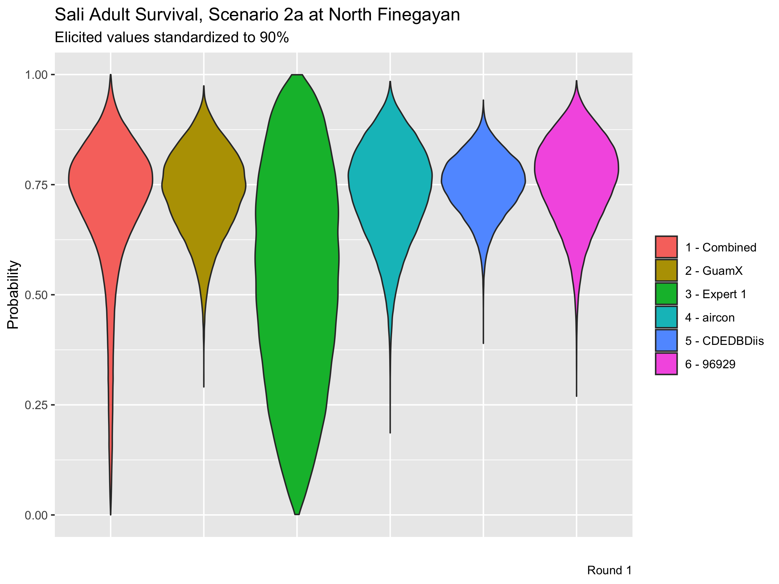

Slide 44


Slide 45
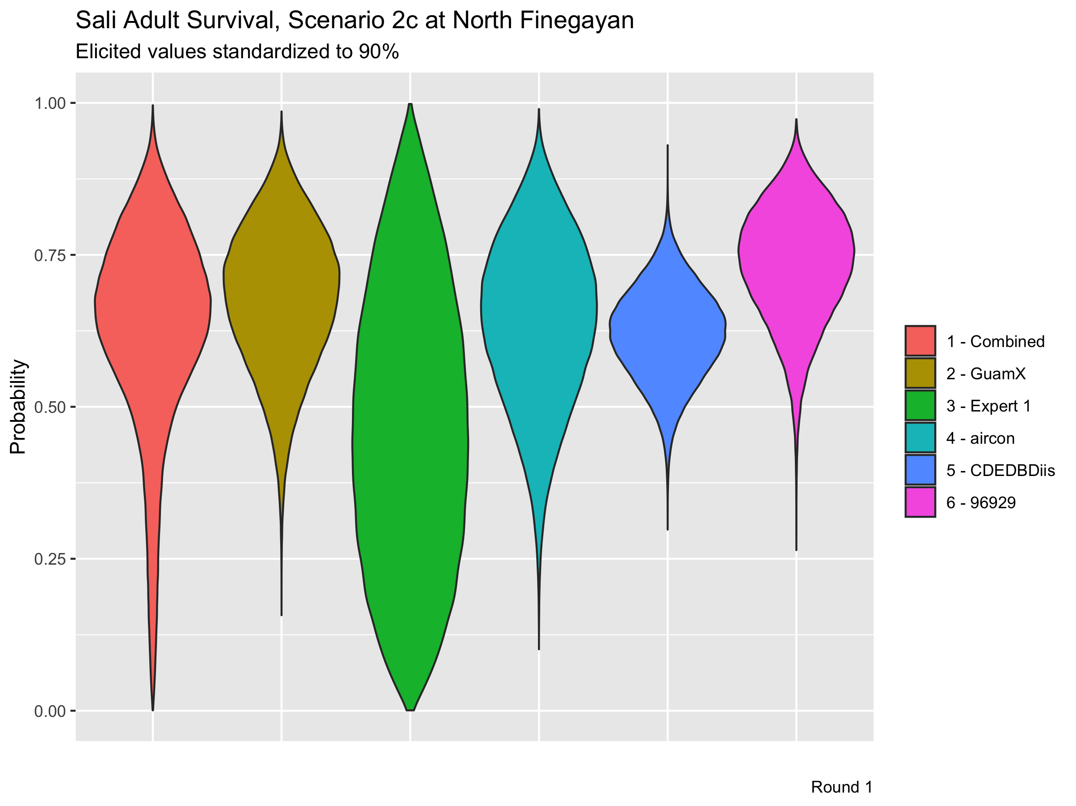

Slide 46
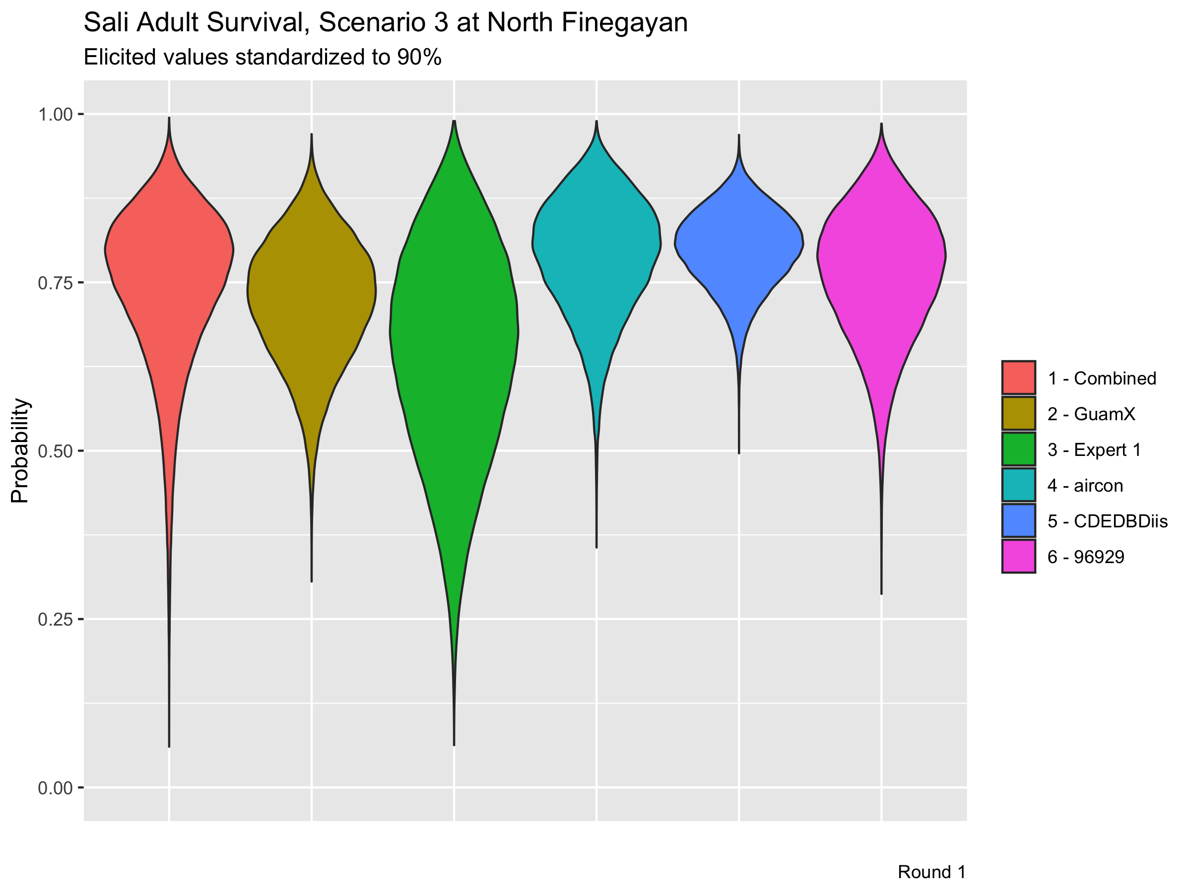

Slide 48
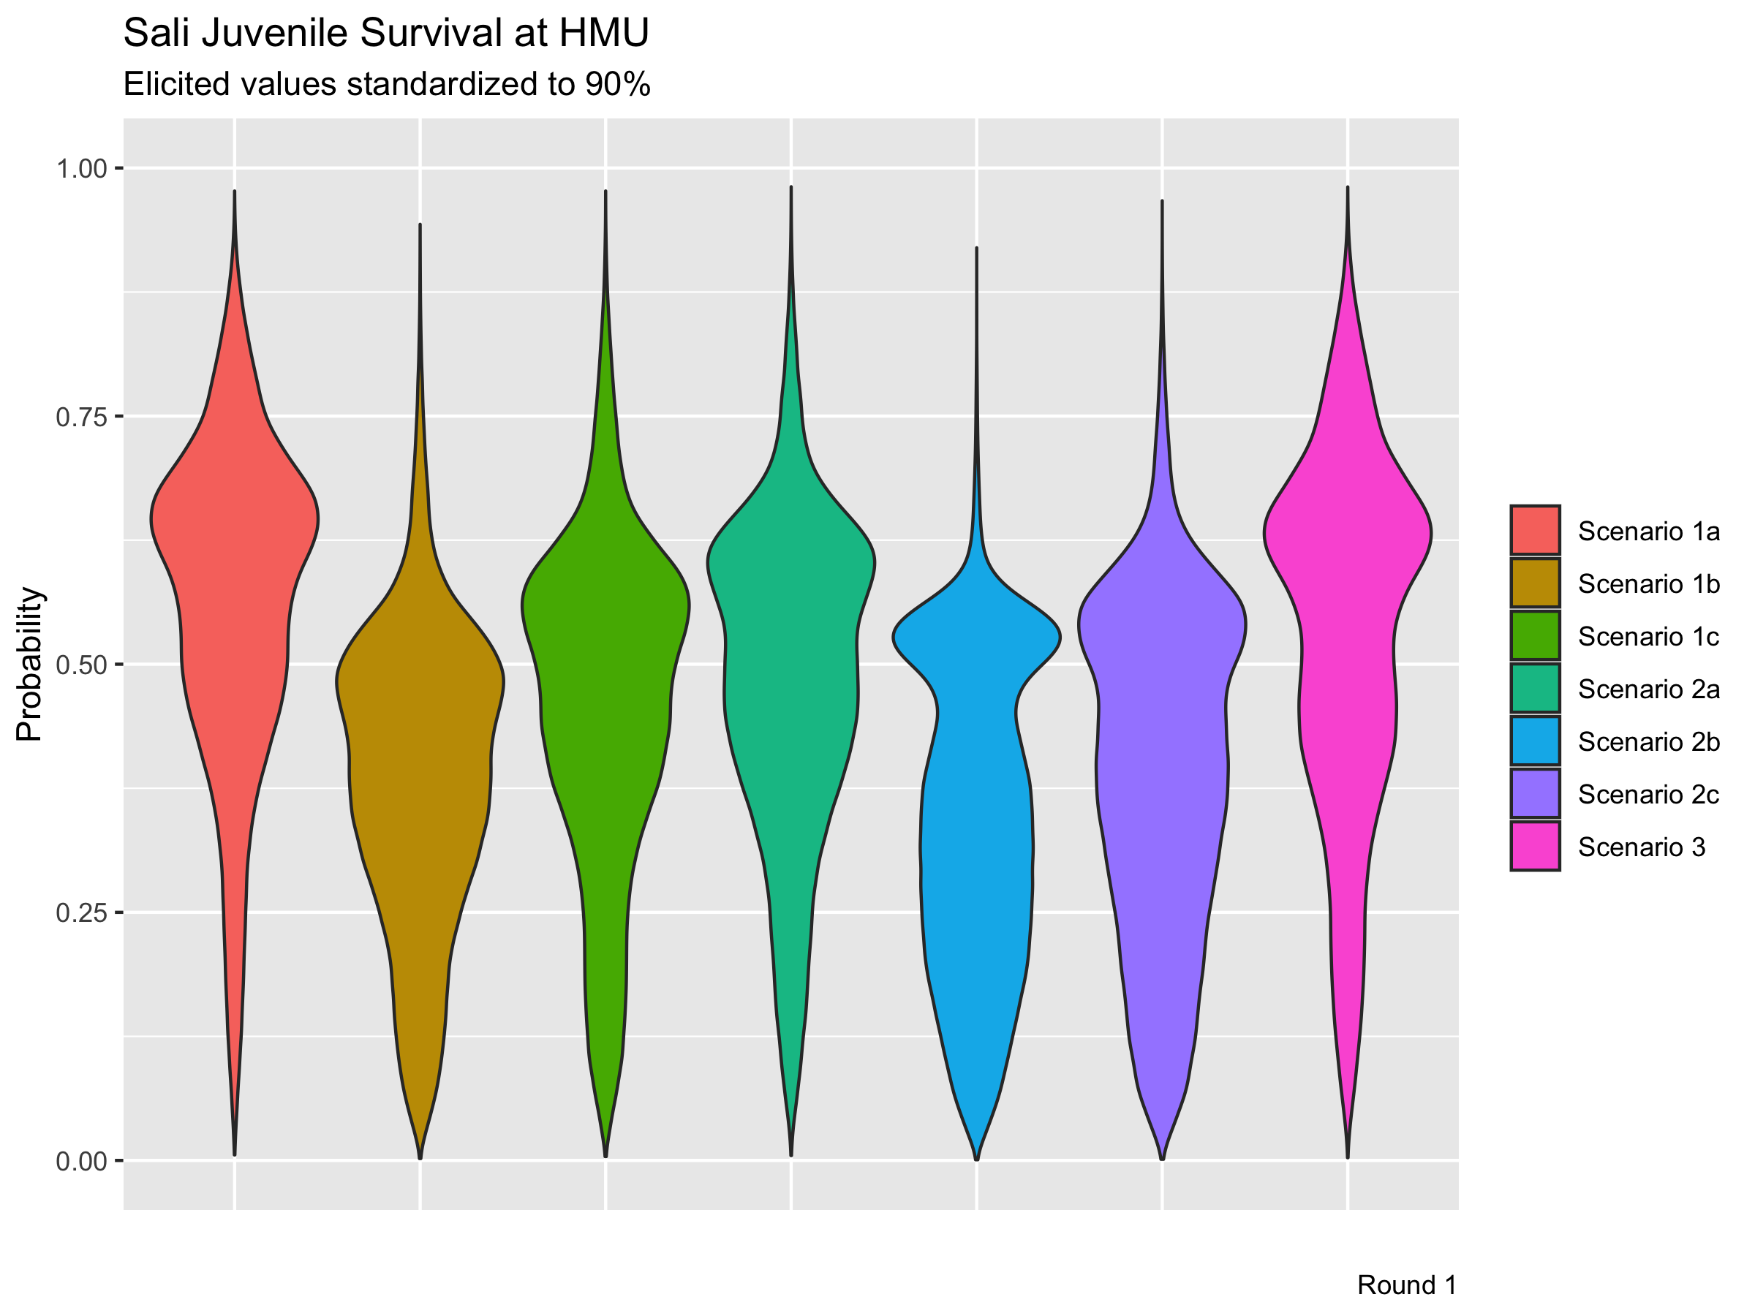

Slide 49
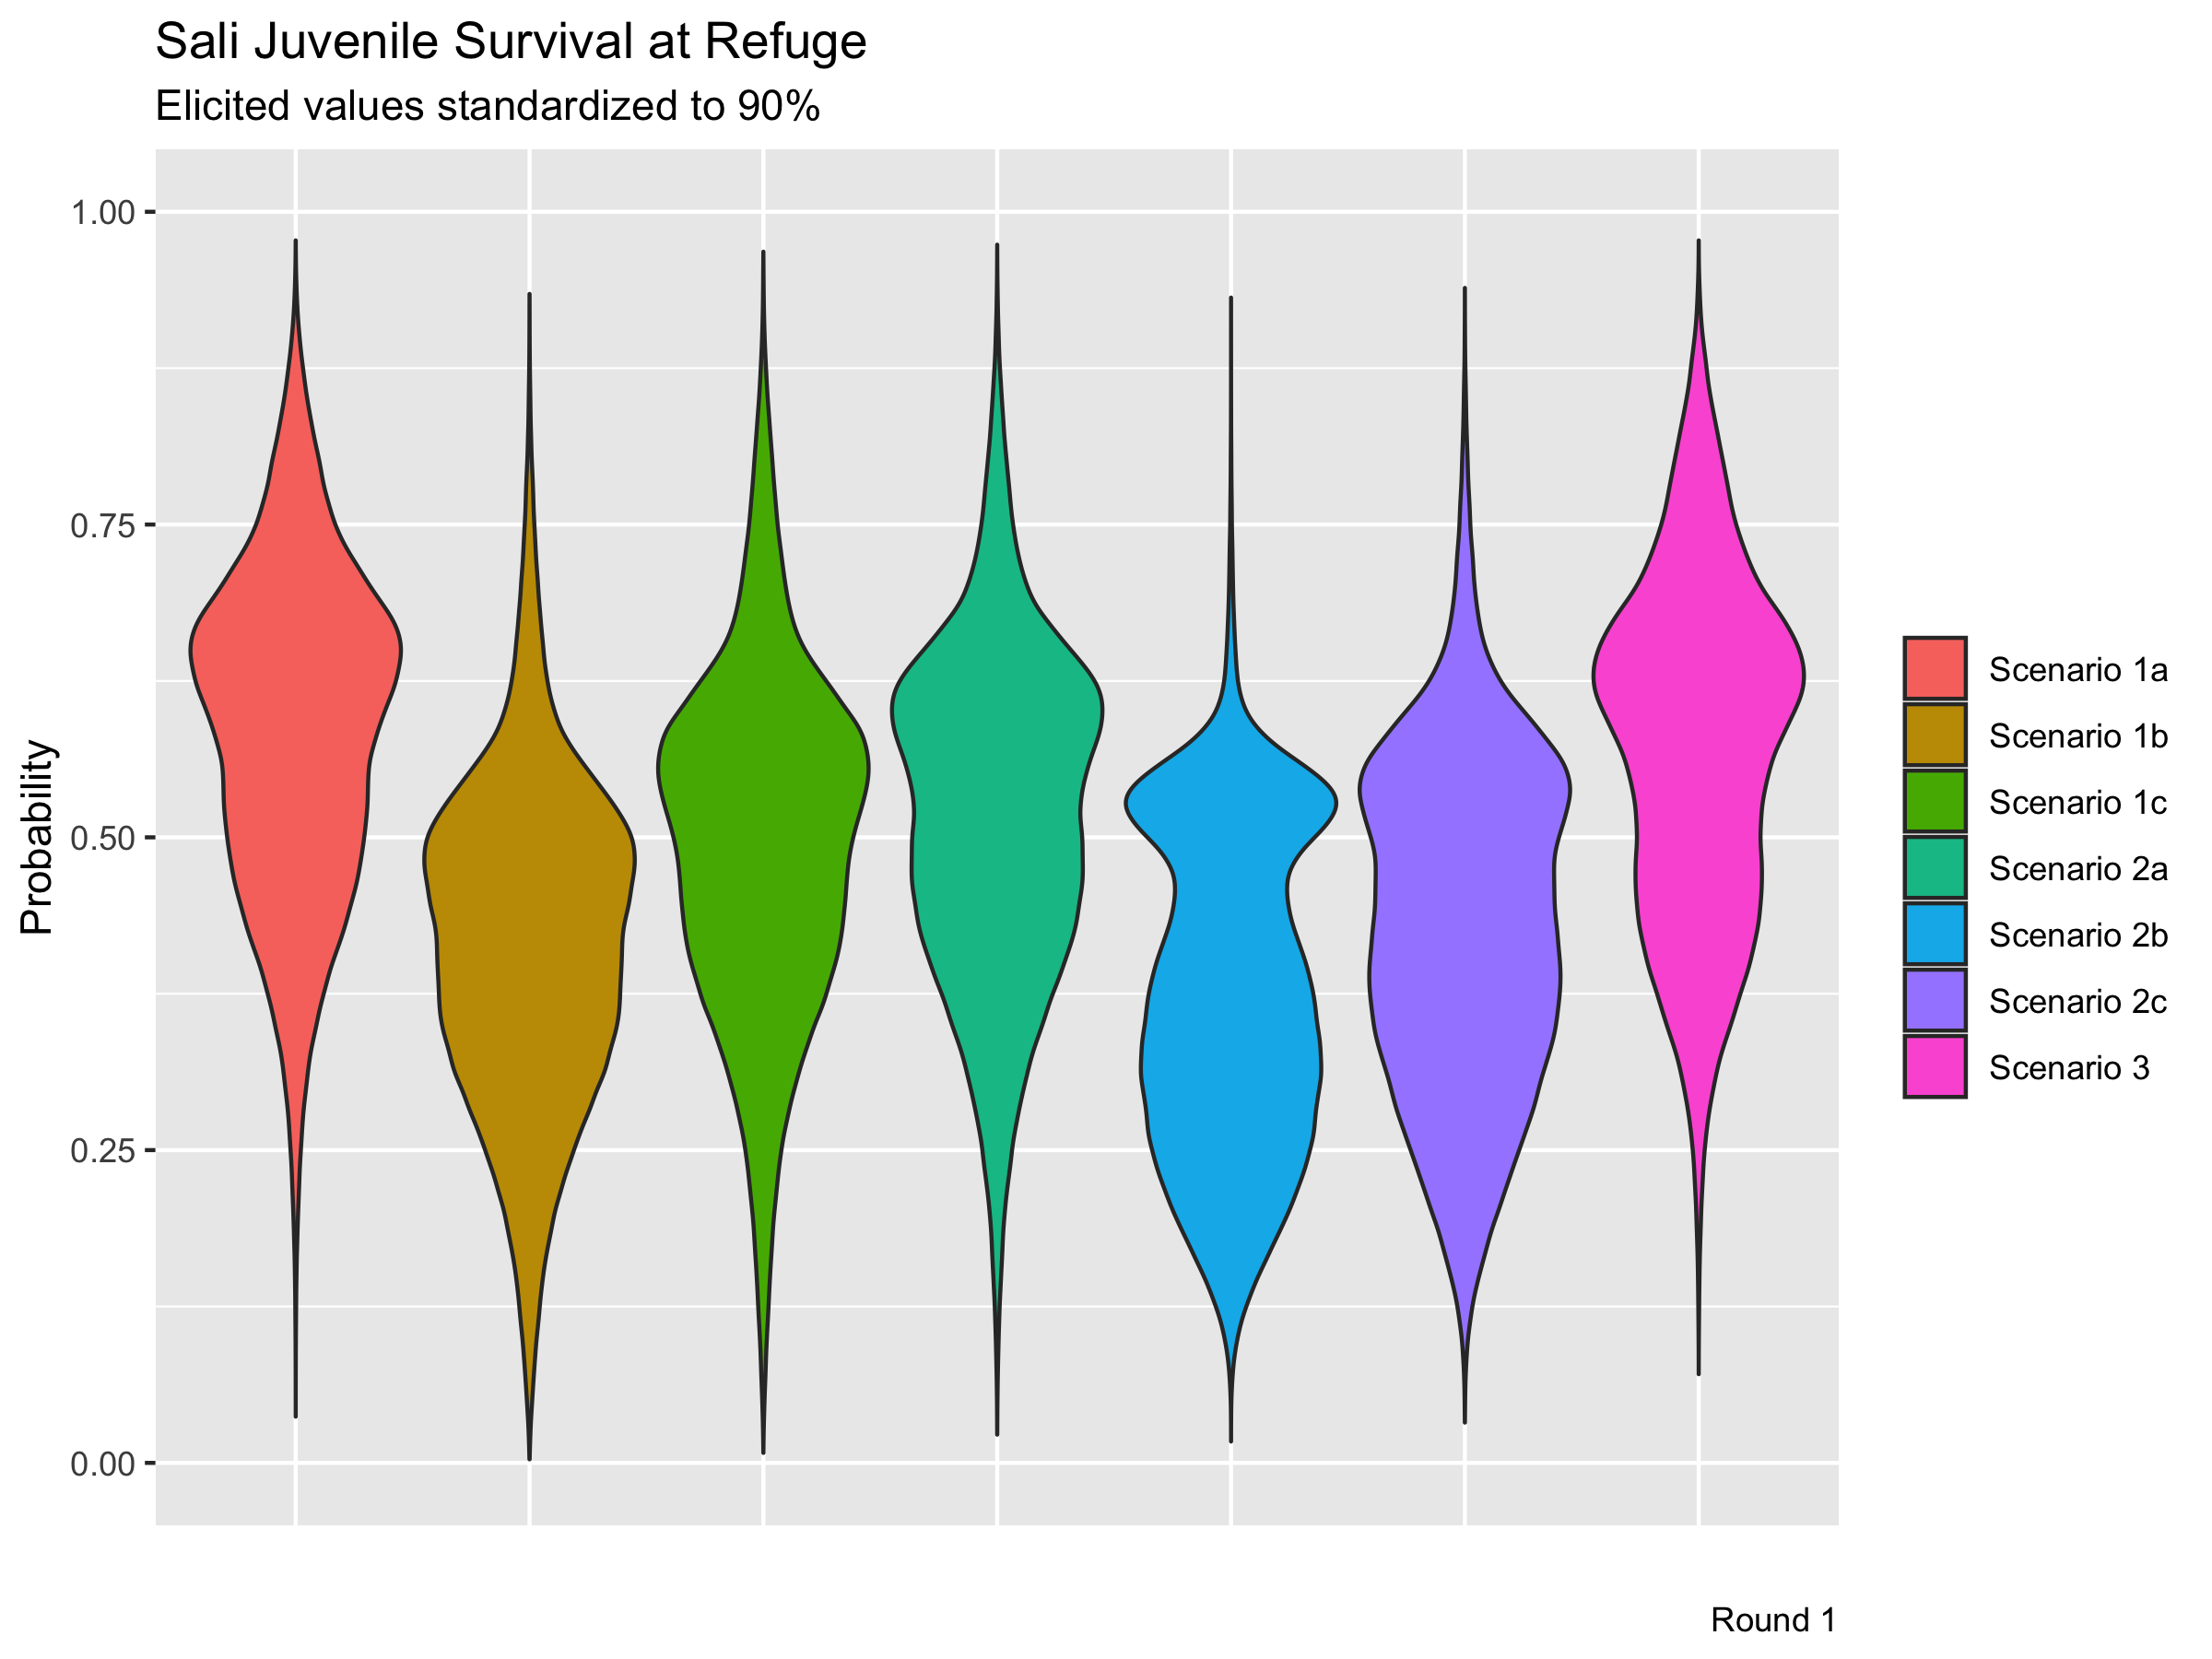

Slide 50
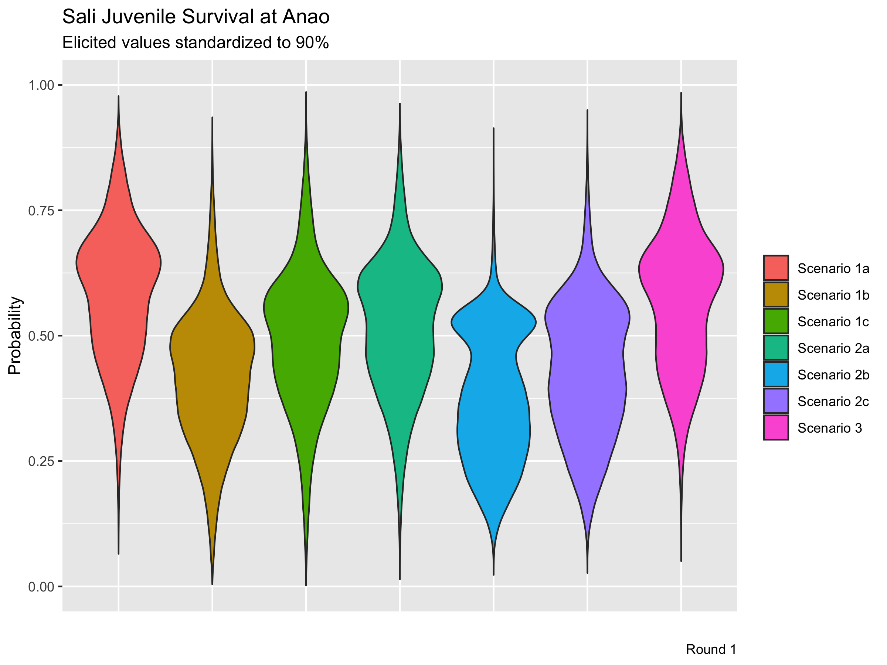

Slide 51
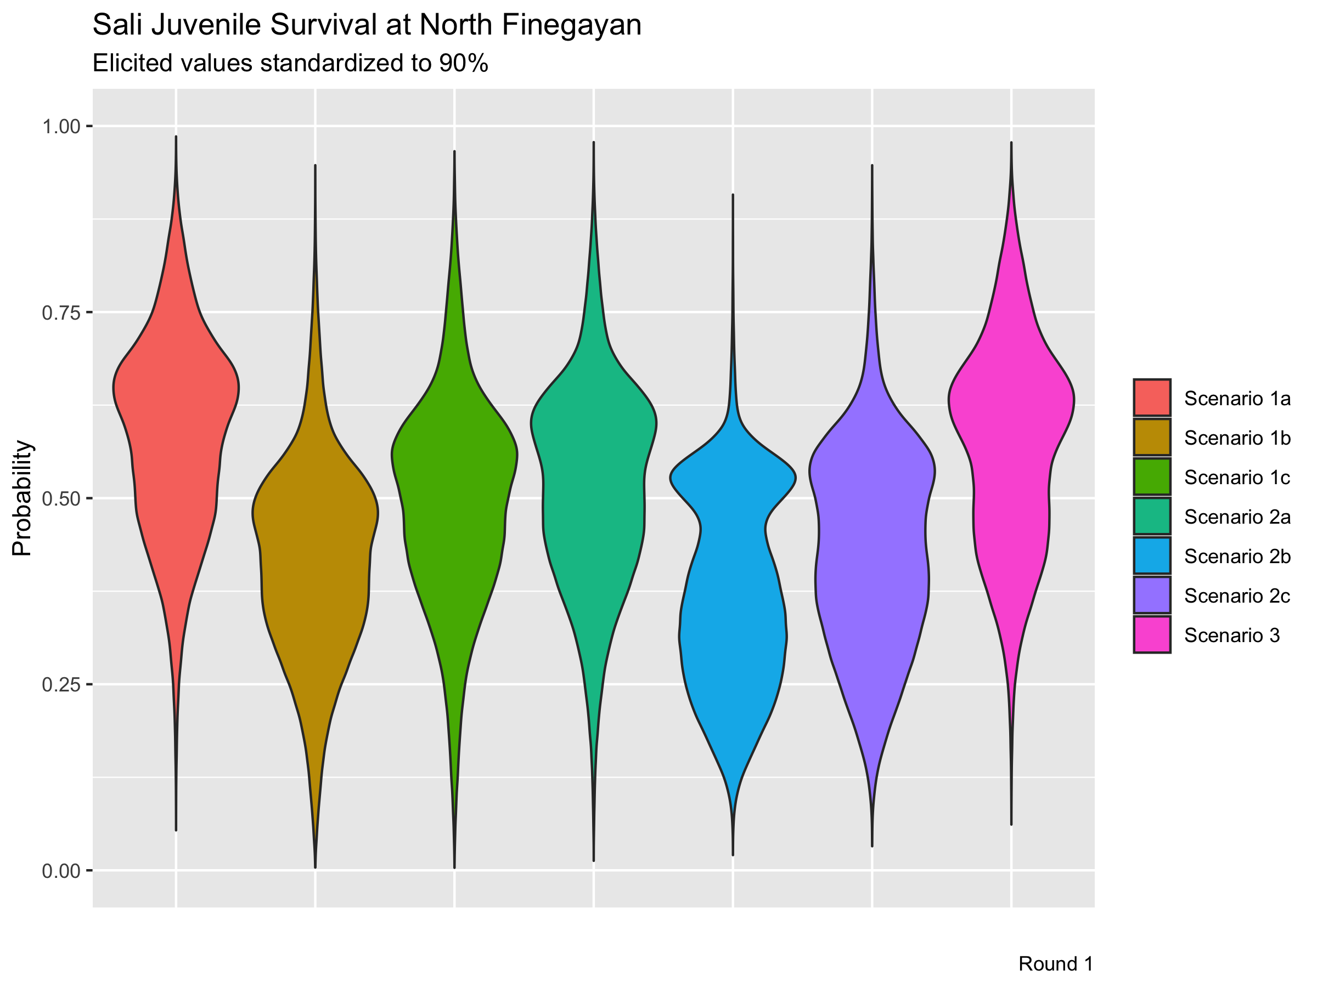

Slide 53
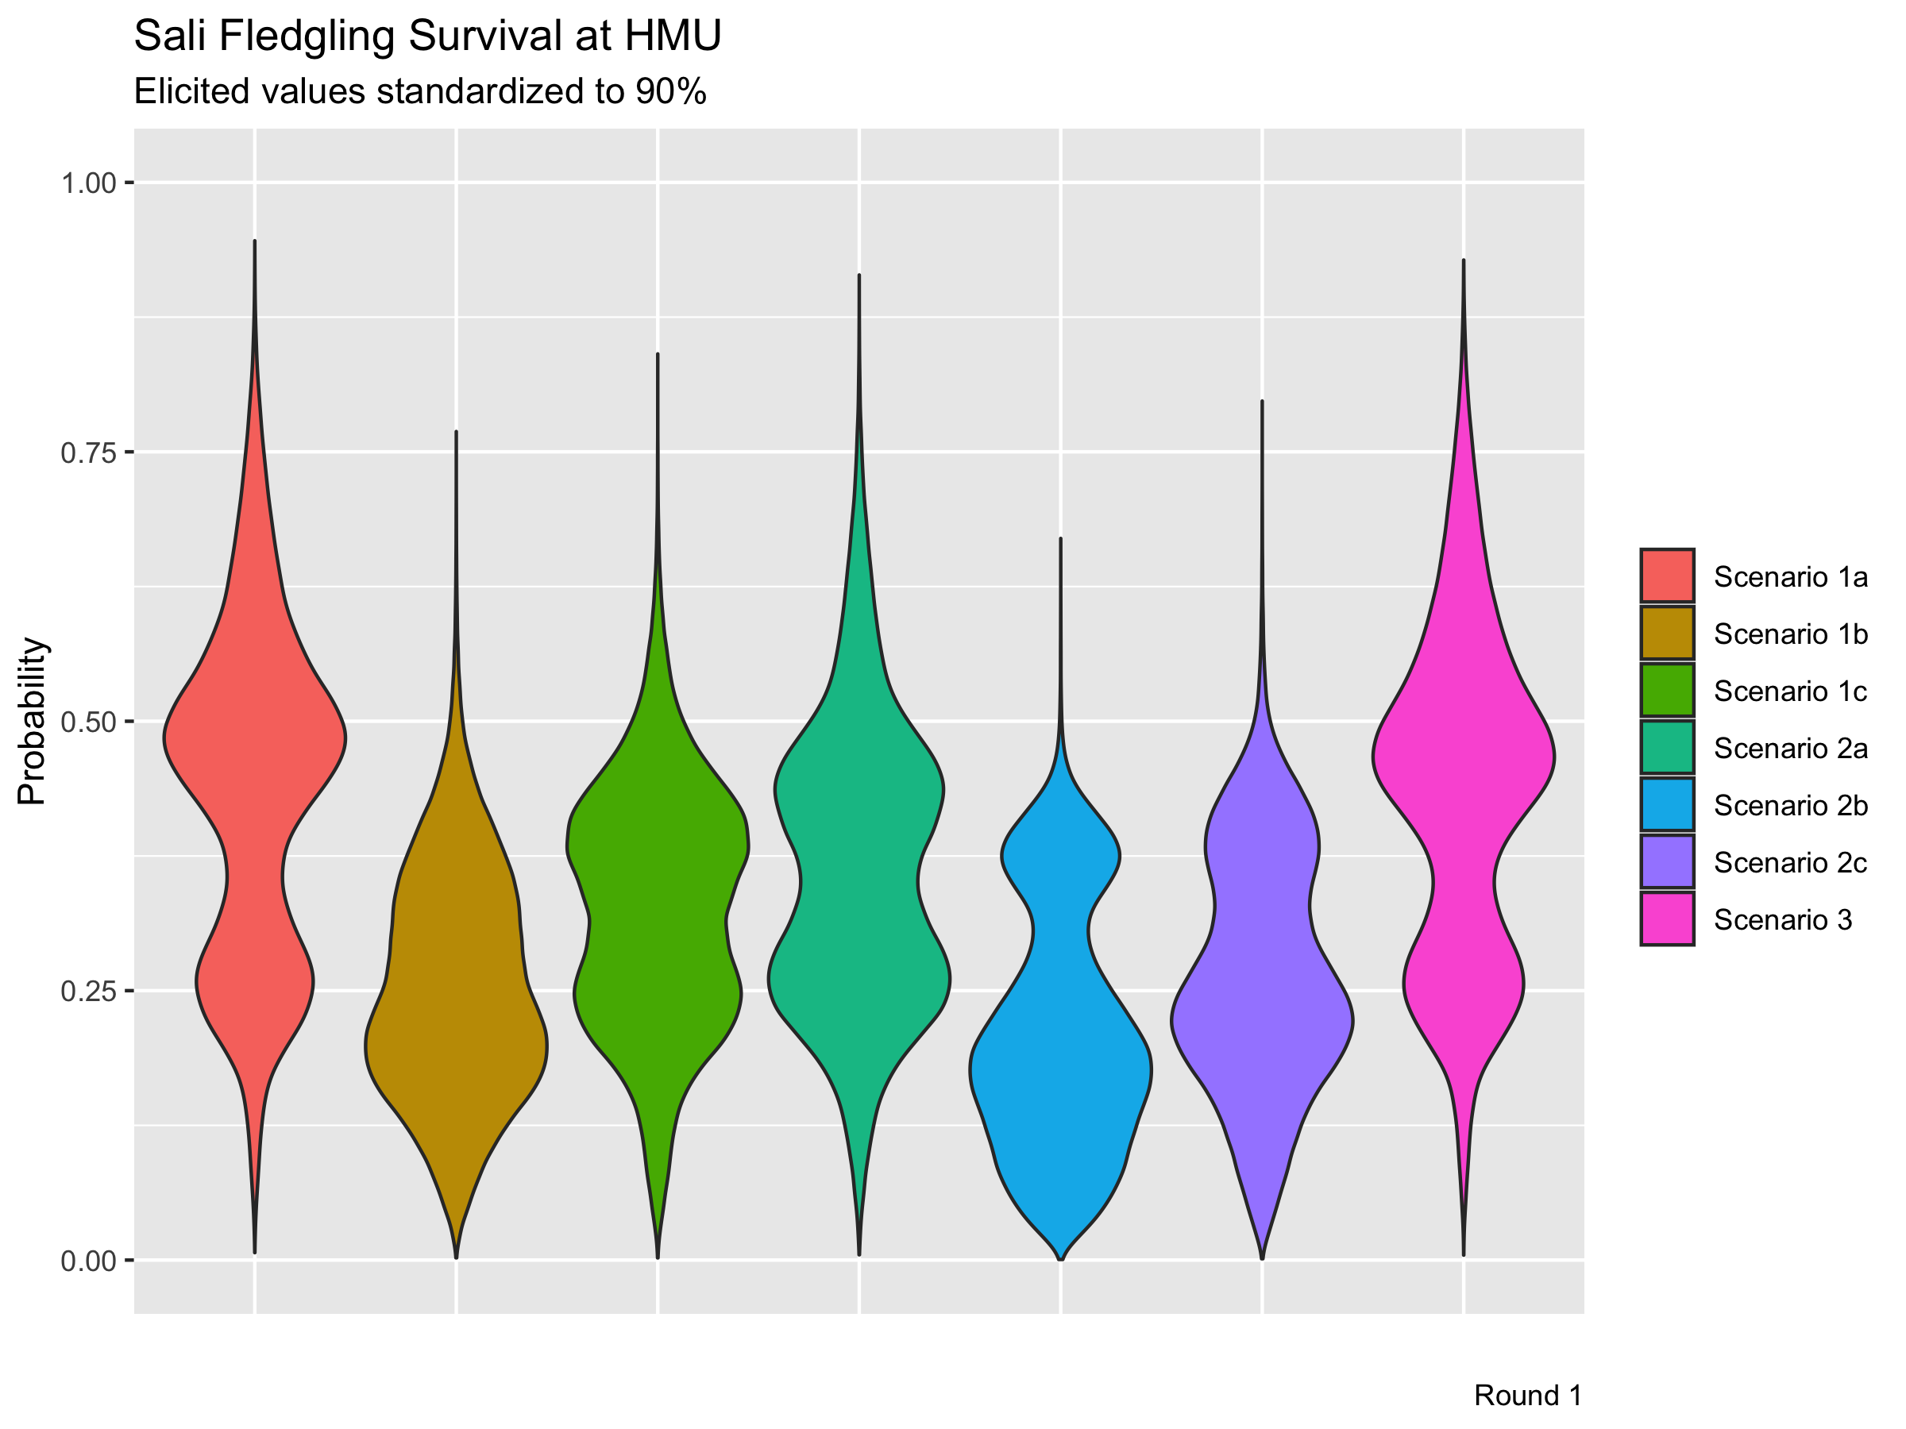

Slide 54
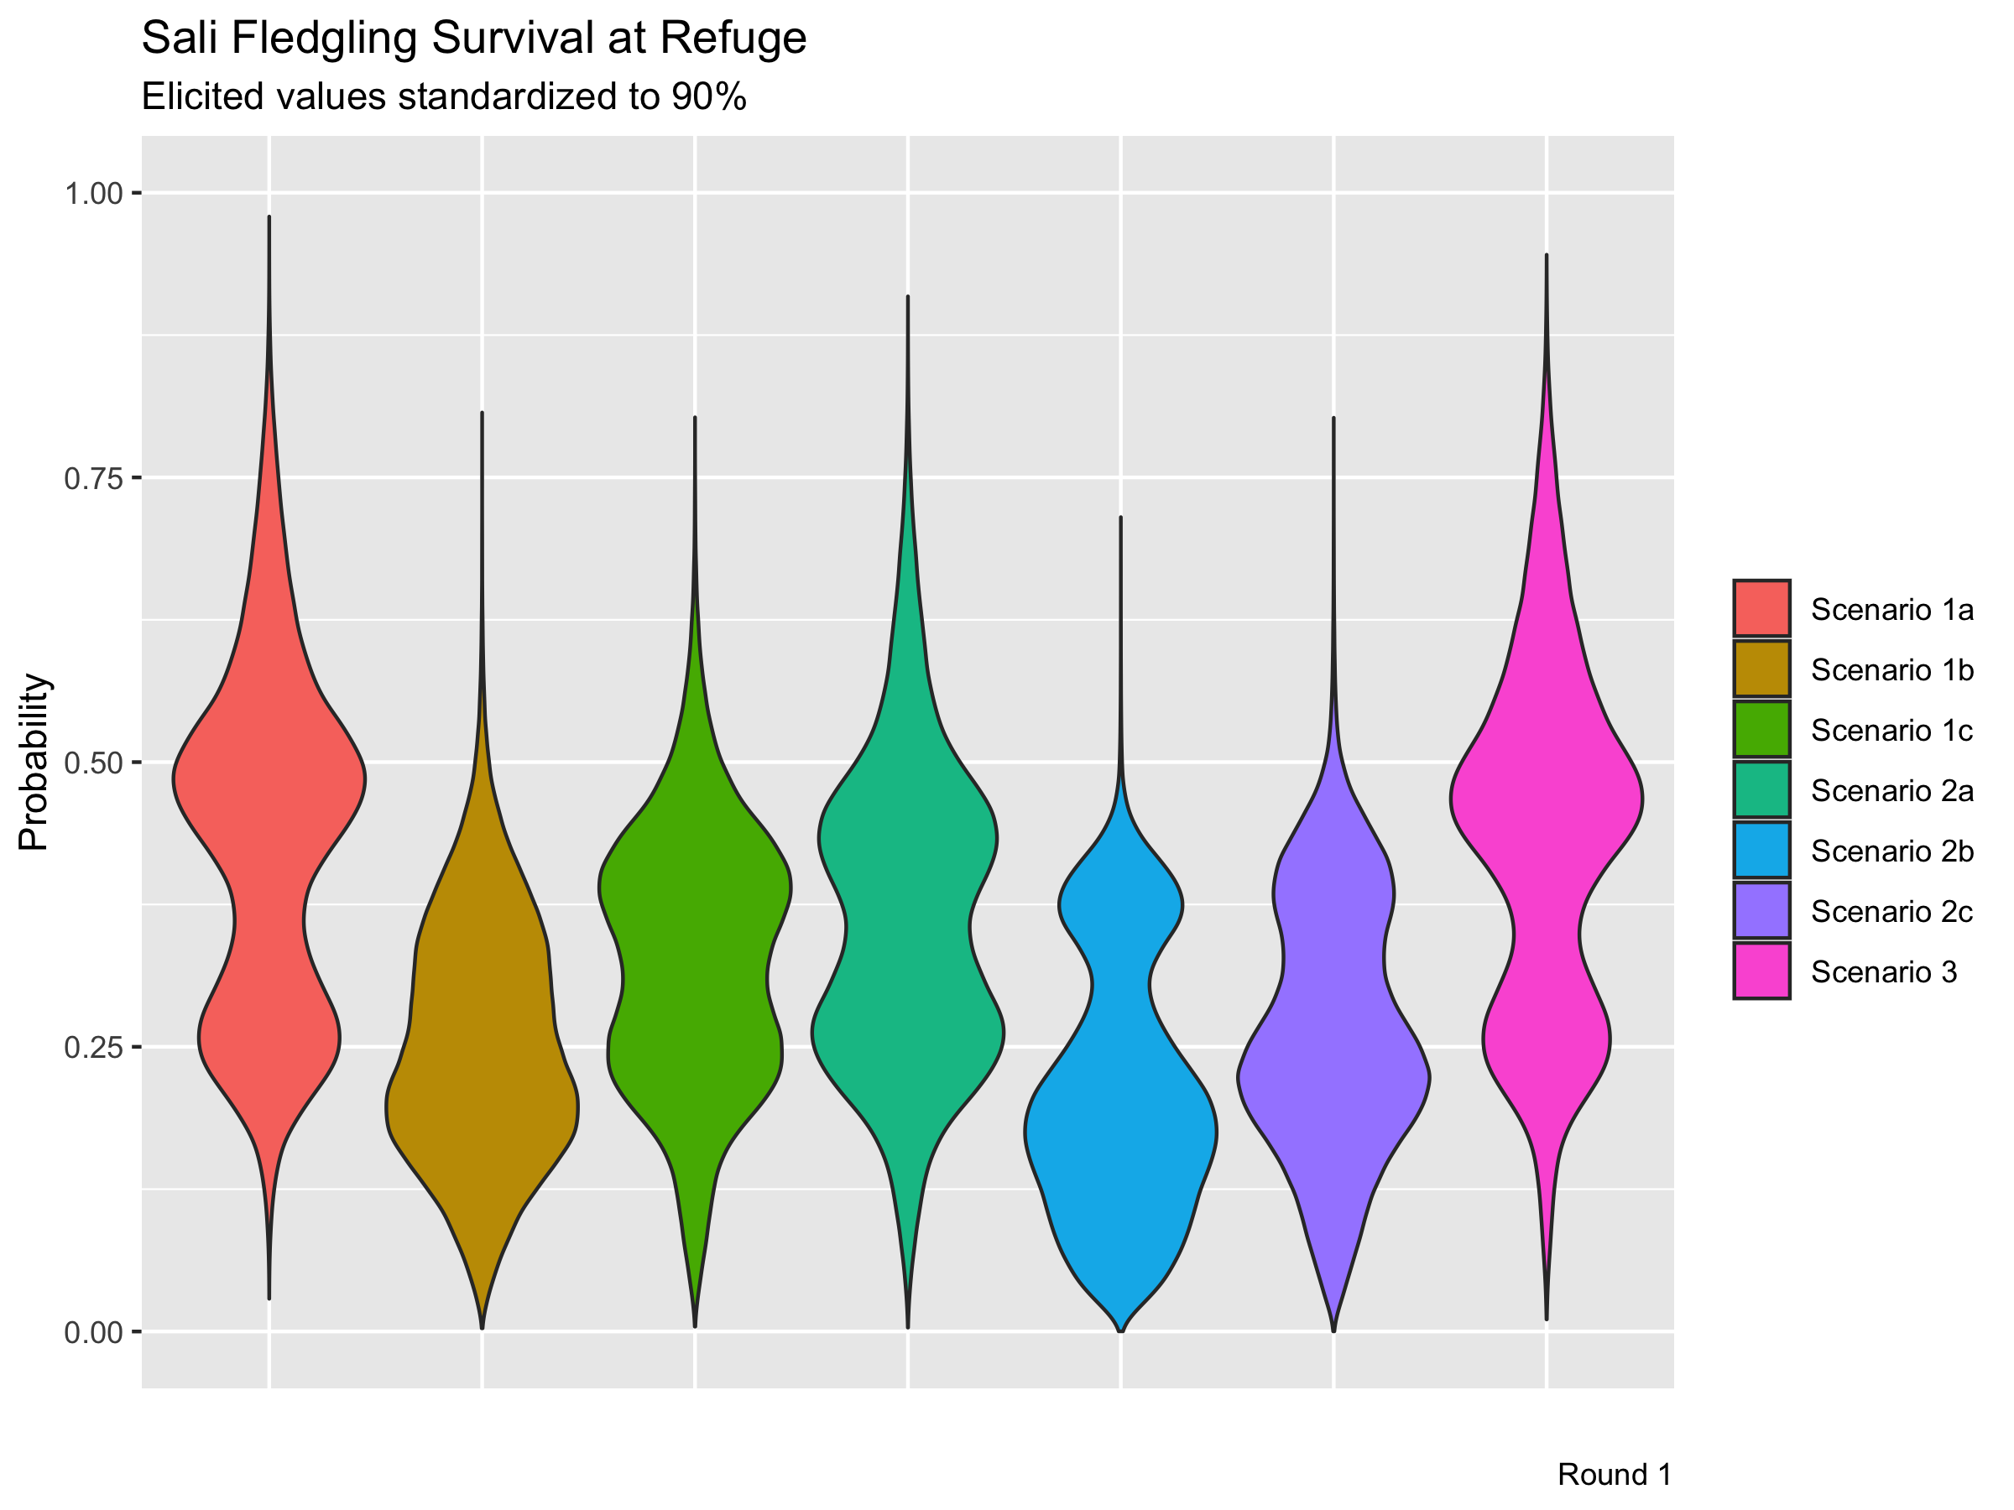

Slide 55


Slide 56
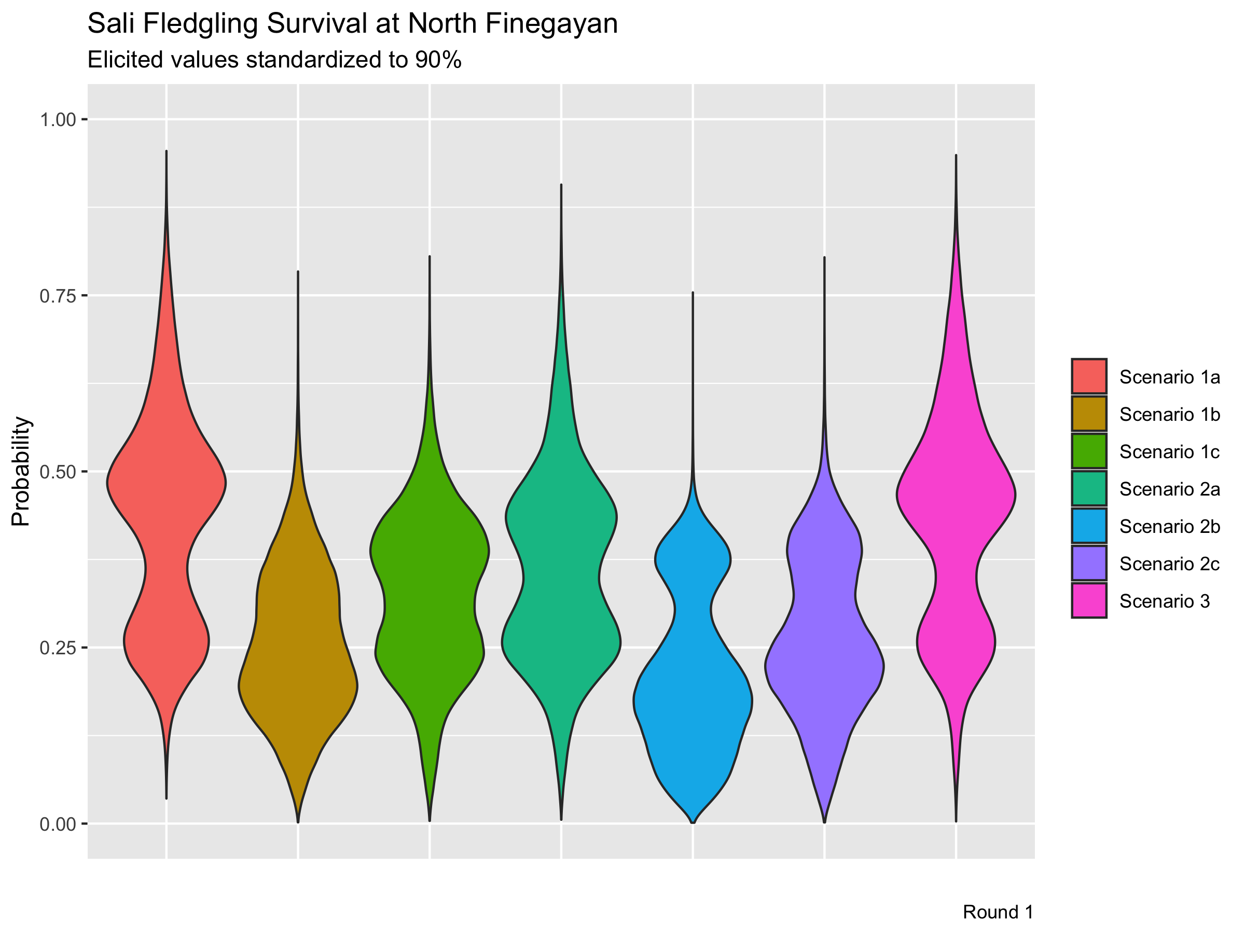

Slide 58
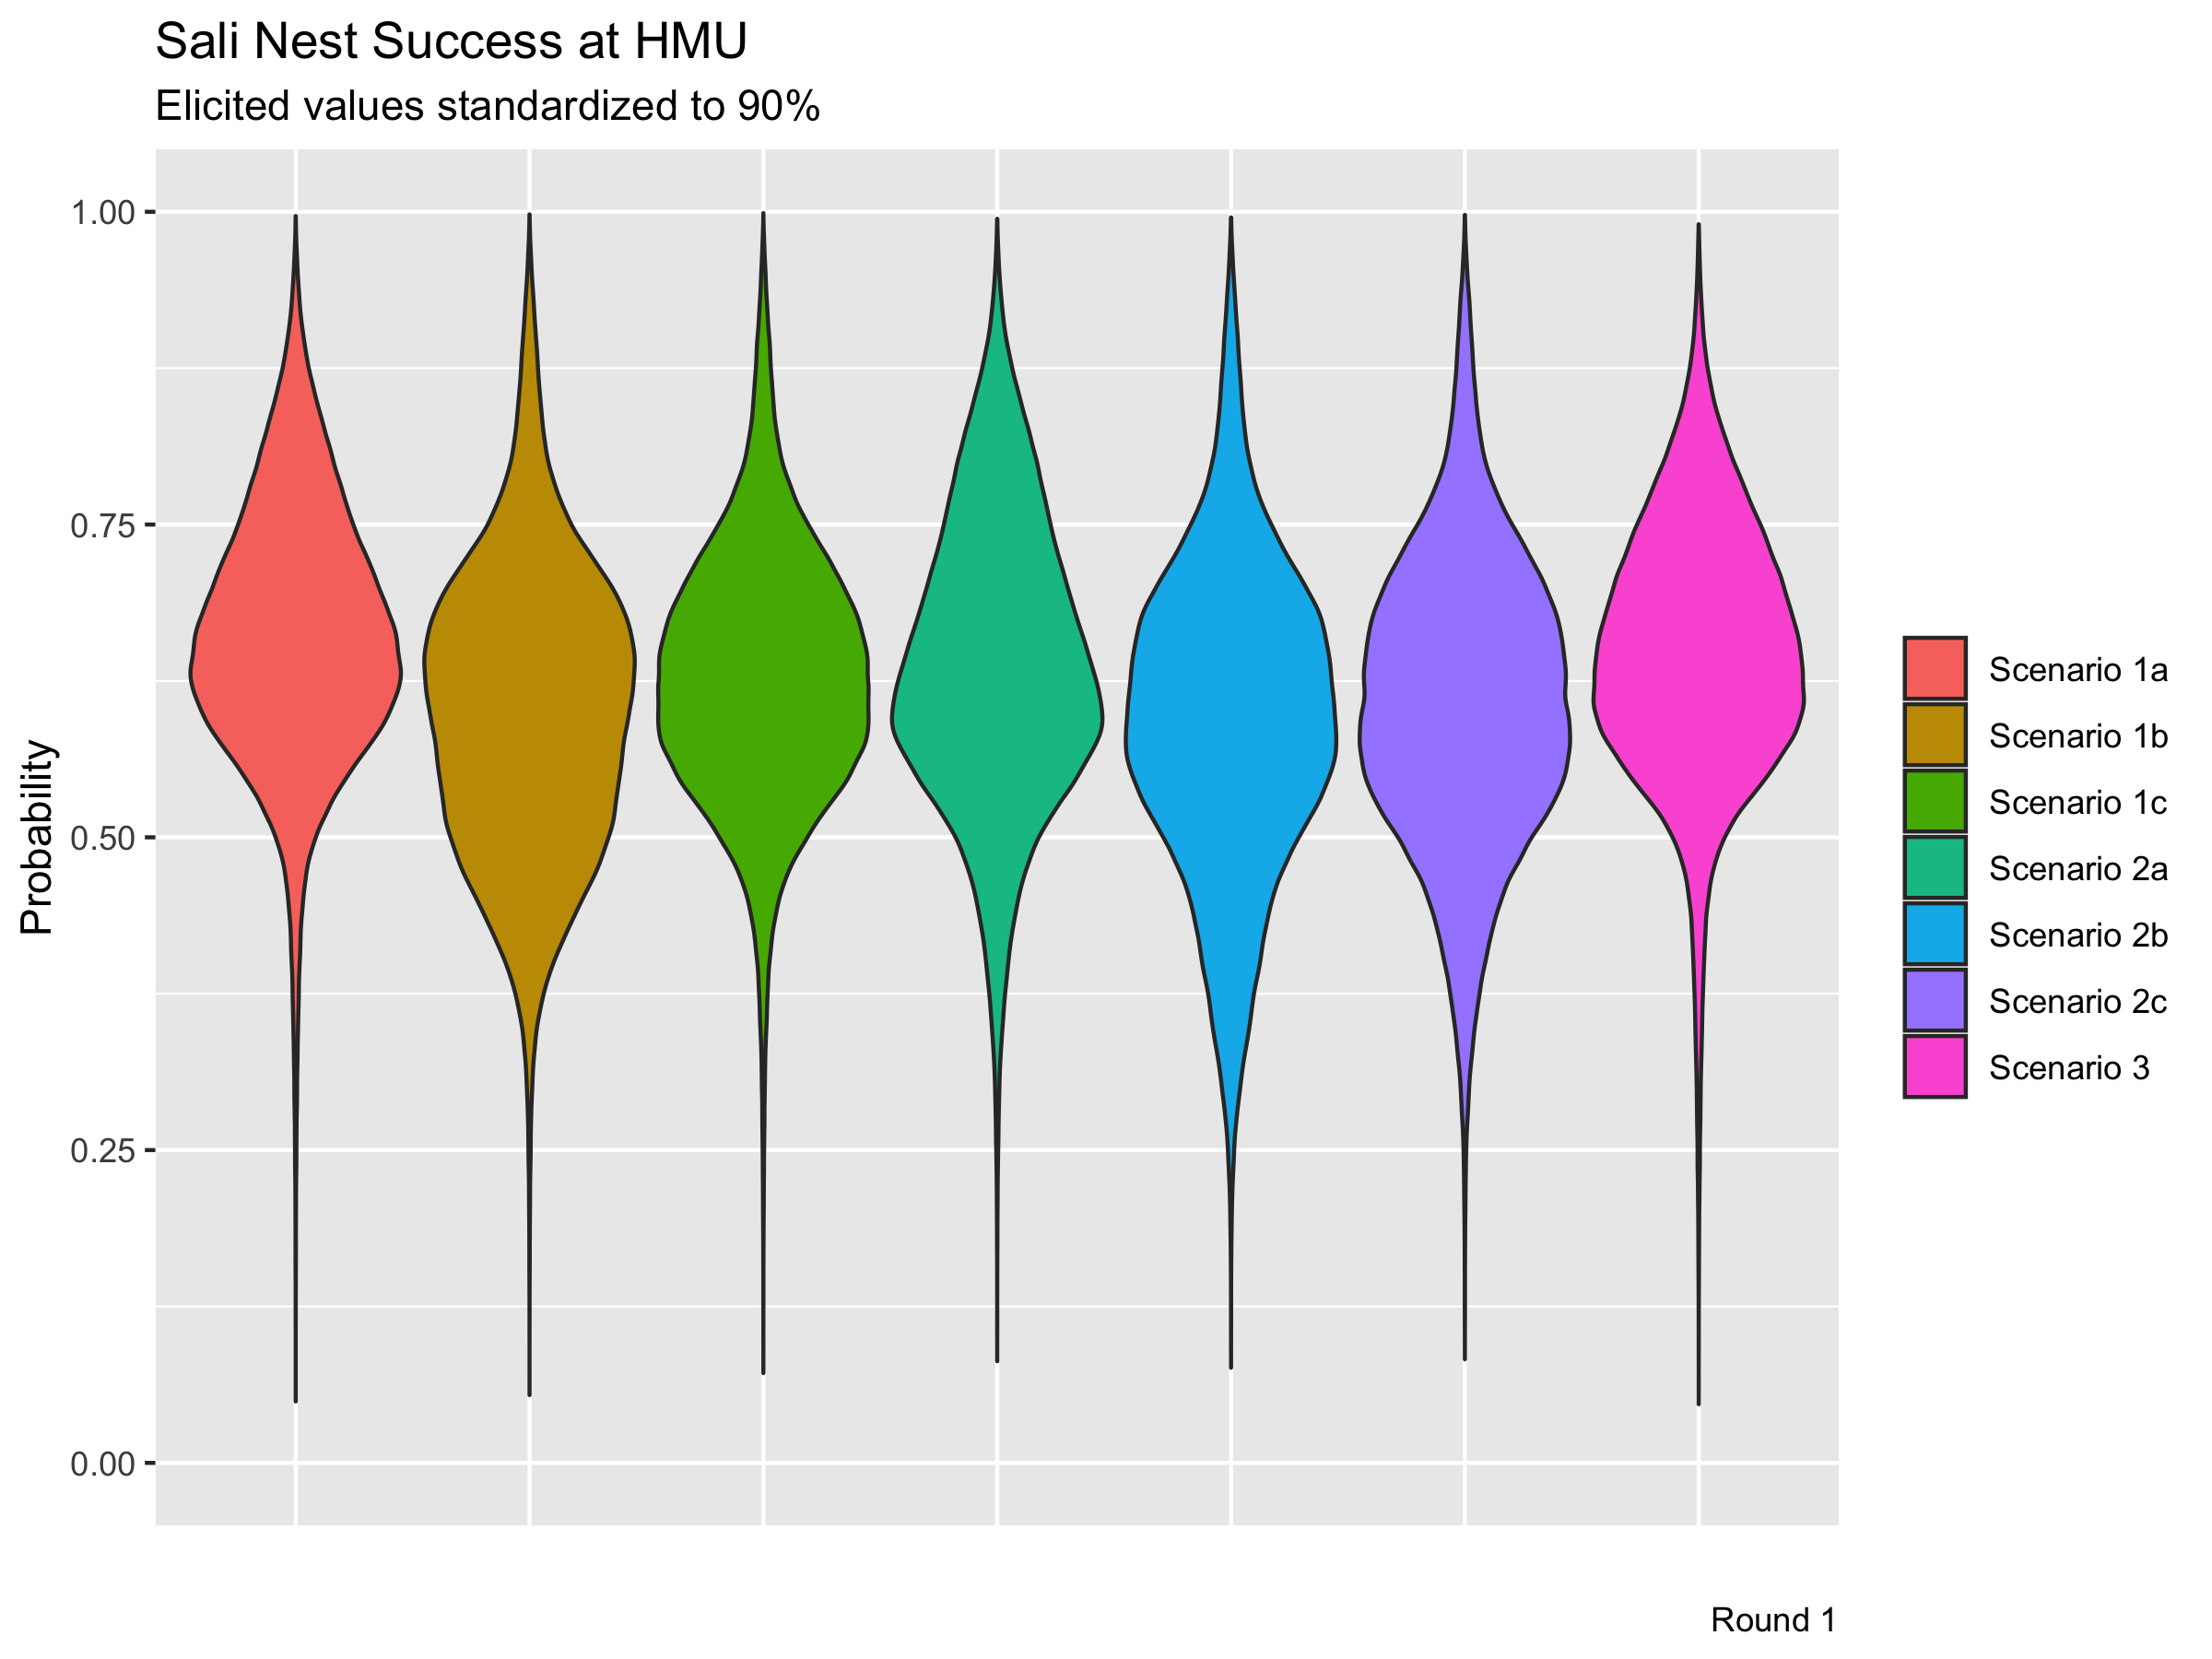

Slide 59


Slide 60


Slide 61
